Slide 1
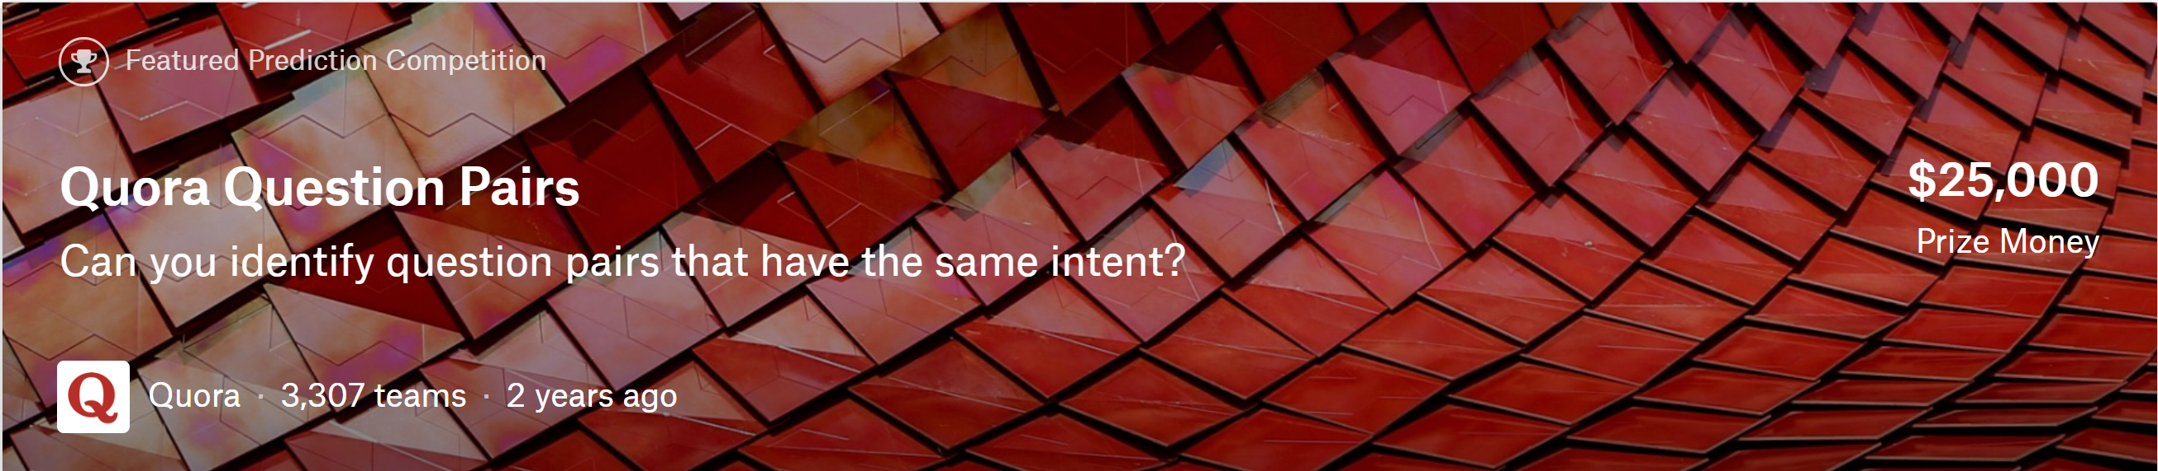
BUAN 6V99.001 – Natural Language Processing
Instructor – Ziaullah Kamran Khan
Presenter: Ali Riahi Samani, Pooja Prasad

Slide 2

TODAY'S DISCUSSION
Problem Statement
Data Overview
Proposed Approach
Evaluation
Conclusion
Tools Used
References

Slide 3


PROBLEM STATEMENT
The problem is generated by Quora, a platform to share general knowledge - about anything. Over 100 million people visit Quora every month and many people ask similarly worded questions. Multiple questions with the same intent can cause seekers to spend more time finding the best answer to their question, also make writers answer similar questions multiple times.
Prediction Problem.
Given a pair of questions q1 and q2, train a model that learns the function:
f(q1, q2) → 0 or 1
where 1 represents that q1 and q2 have the same intent and 0 otherwise.
Notes:
The problem is about modelling whether a pair of questions on Quora is the same question
Doing so will make it easier to find high quality answers to questions resulting in an improved experience for Quora writers, seekers, and readers.

Slide 4

PROPOSED APPROACH
Deep Learning
E
V
A
L
U
A
T
I O N
train.csv
EDA
Conclusion
test.csv
Data Cleaning
Semantic Analysis
Semantic Analysis
Read Data
Data Normalization
NLP
Similarity
Data Preprocessing
Models
Notes:
Text cleaning: convert all tokens to lower case, remove punctuations, special tokens, etc.
Text normalization: Restore abbreviations (e.g. "What's" to "What is", "We're" to "We are", etc.) using regular expression, replace number-like string with "number" and replace currency symbols with "USD" abbreviation.

Slide 5
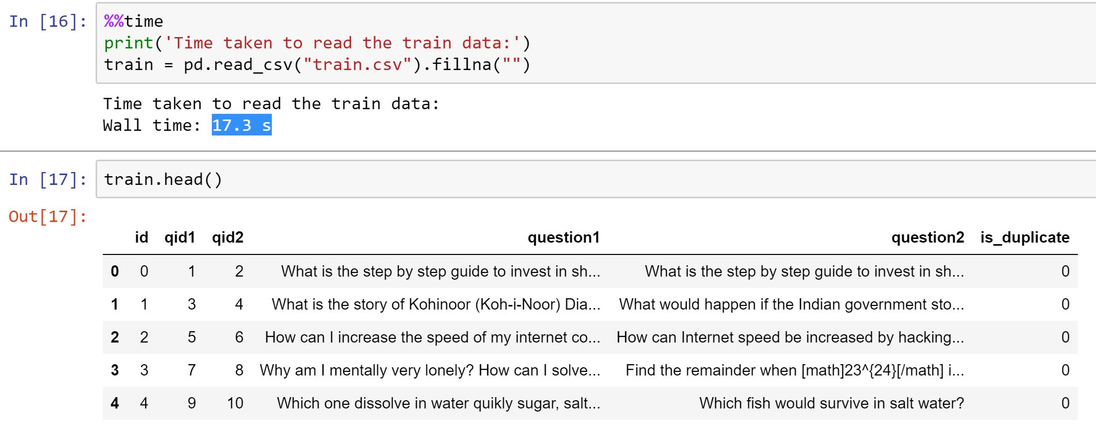
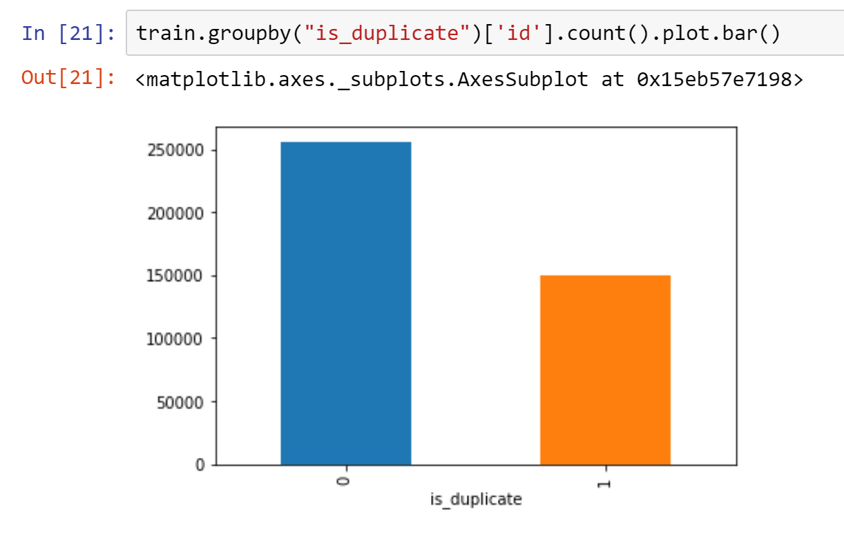
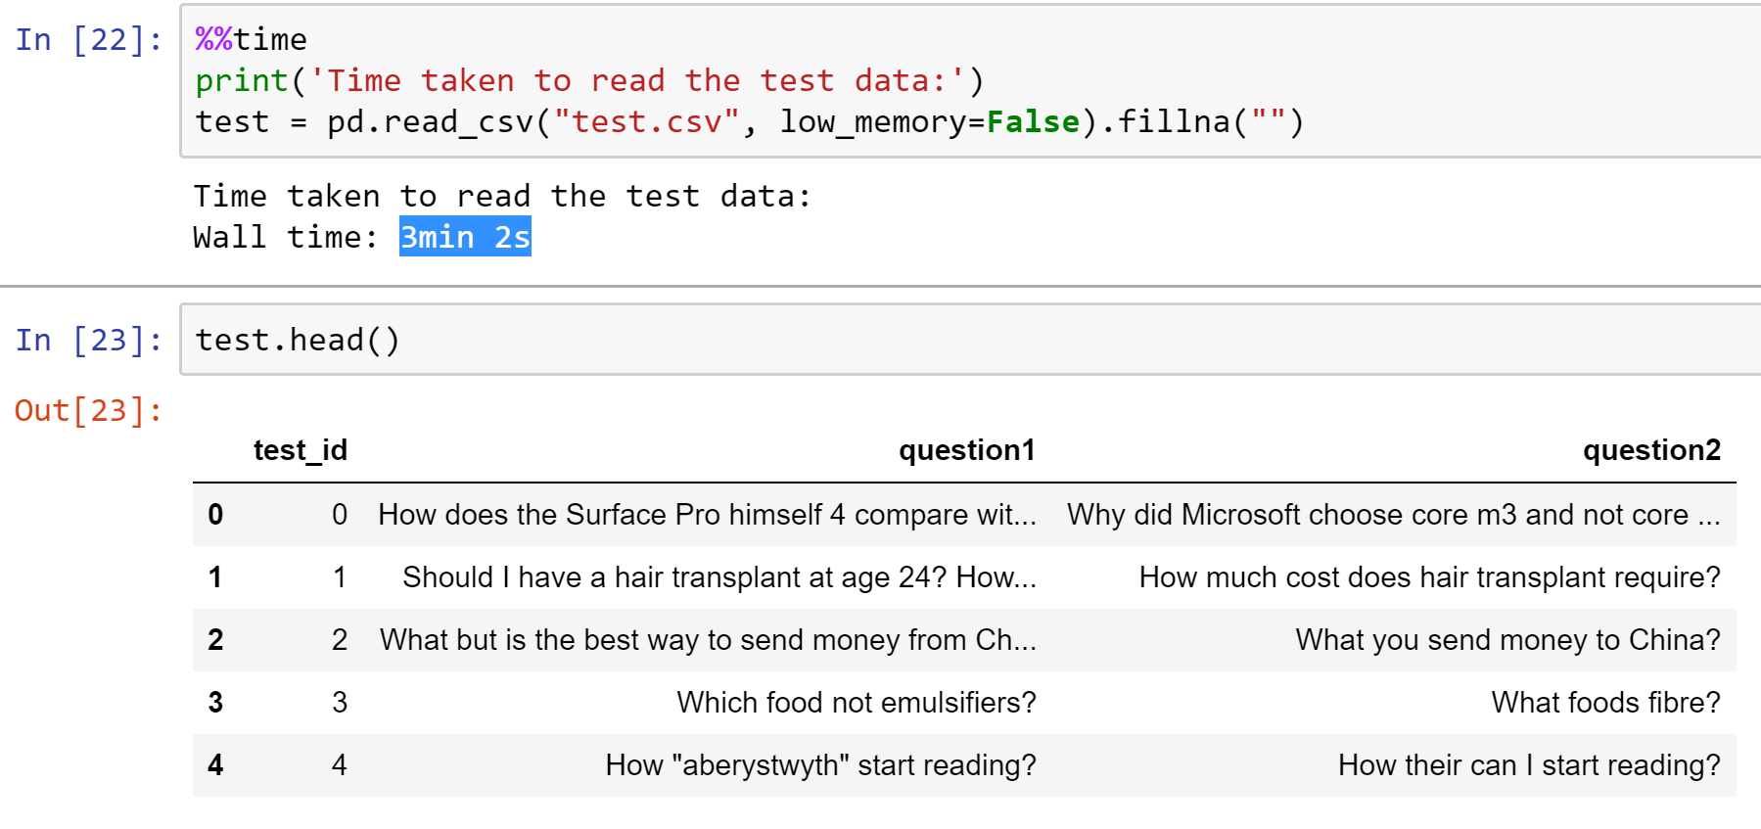
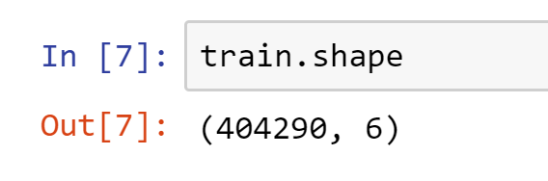
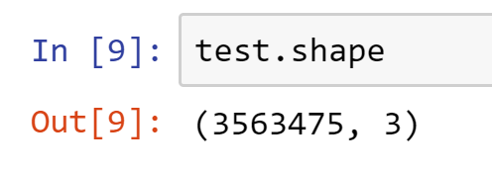
DATA OVERVIEW
Notes:
Lets have a glance over data set

Slide 6
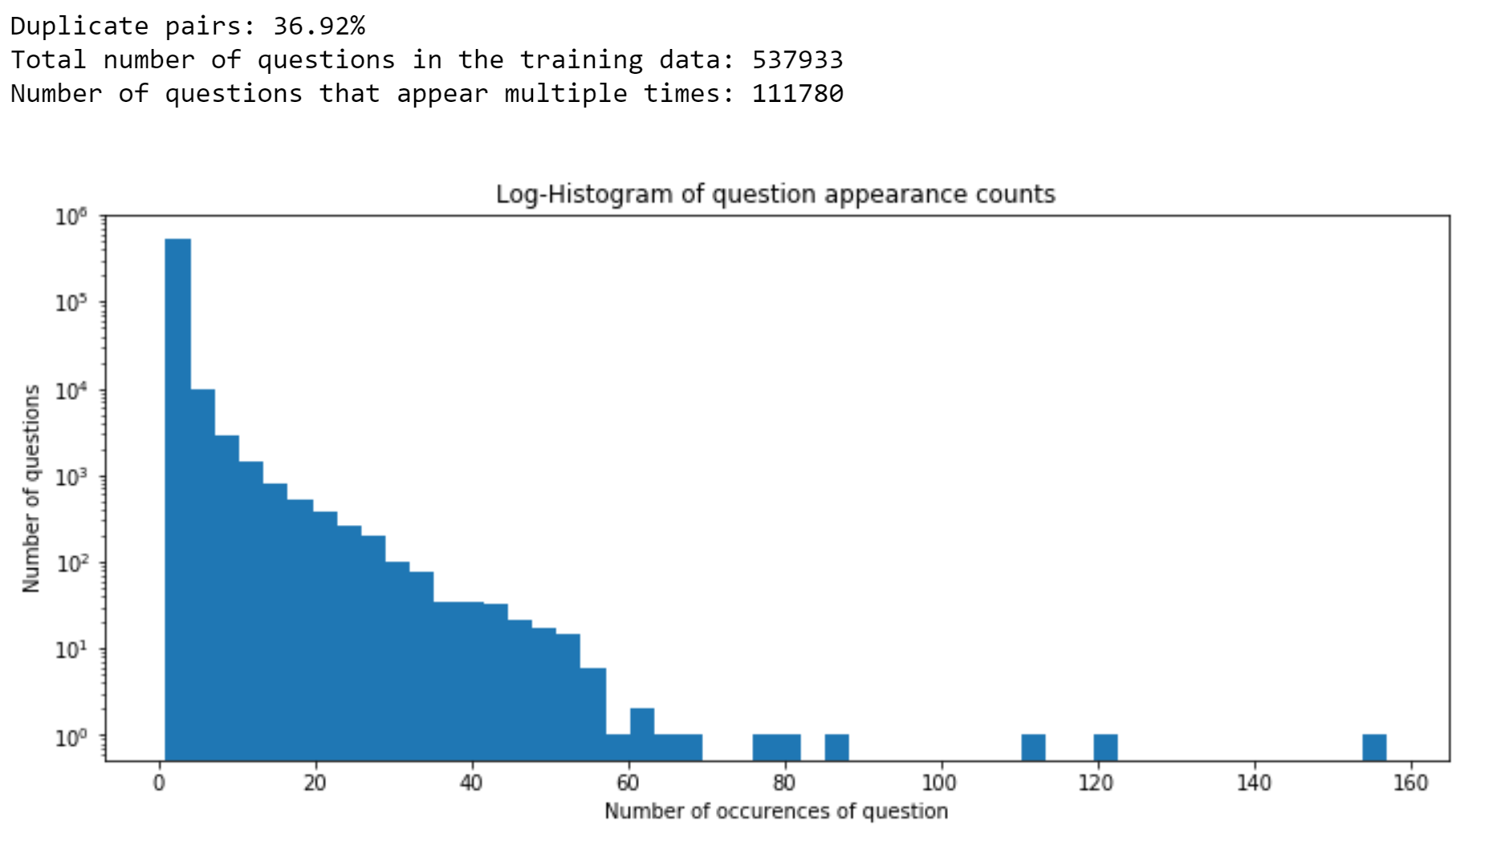
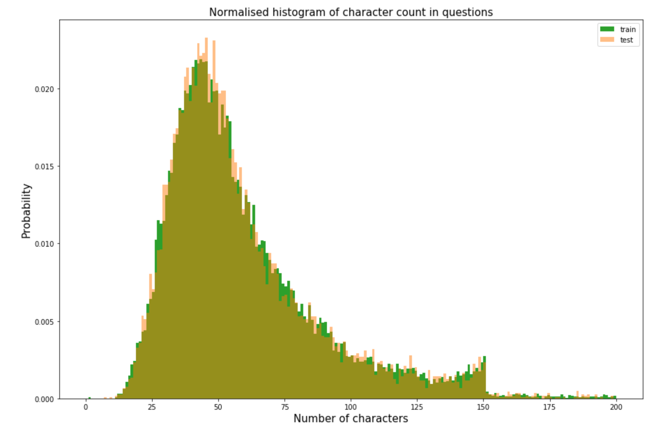
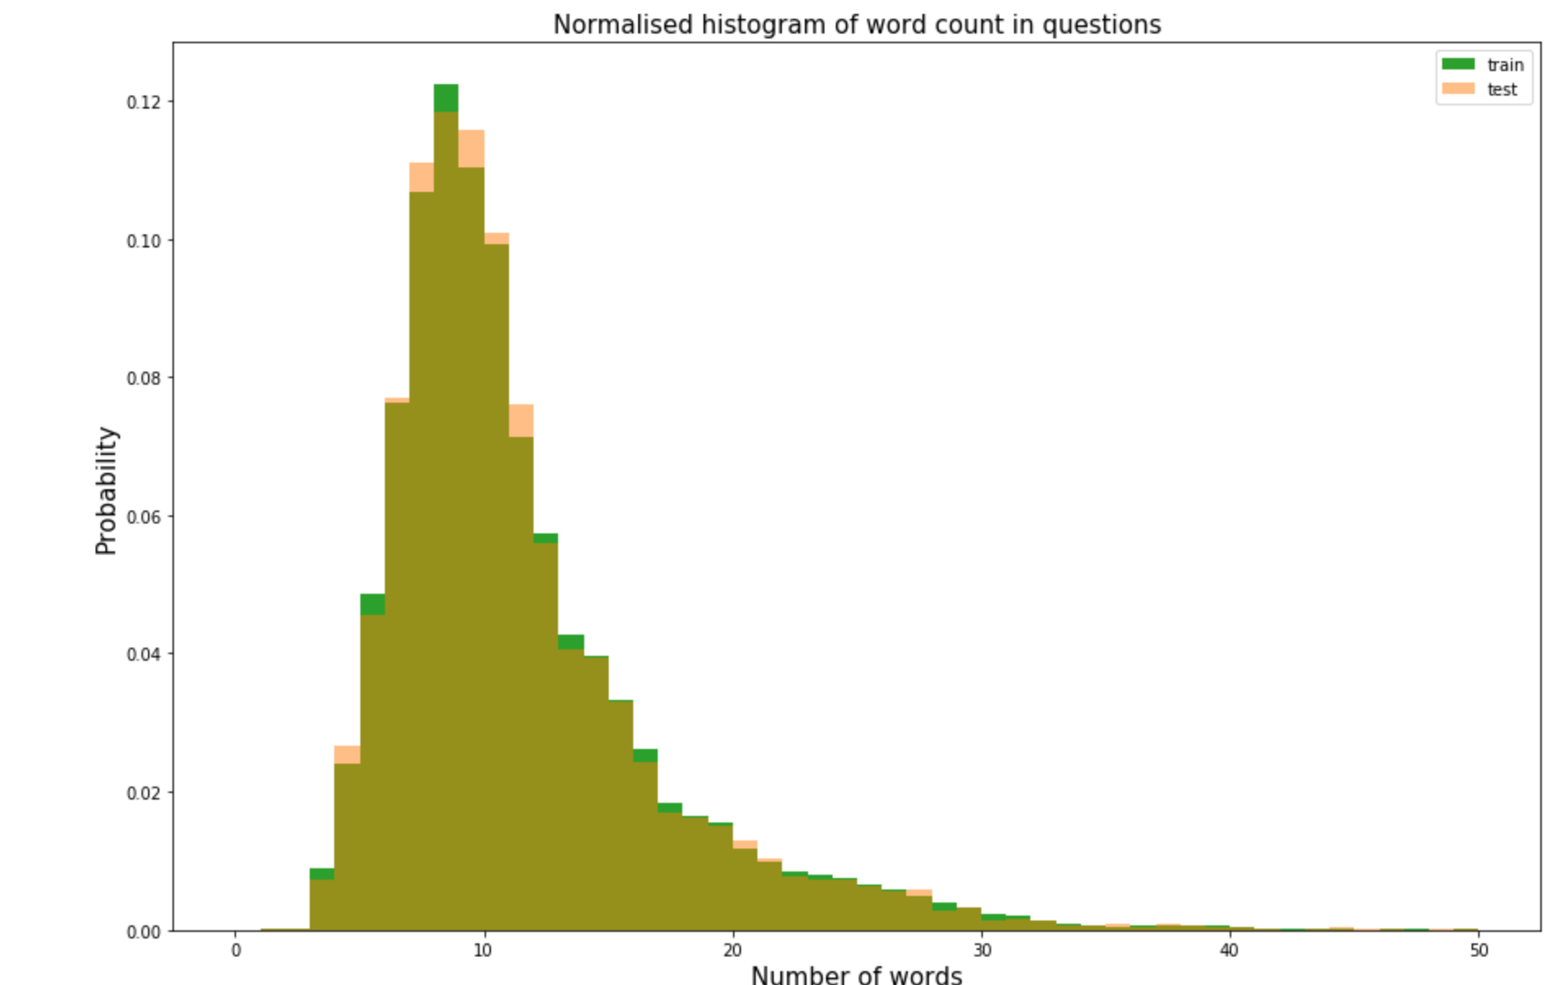
DATA OVERVIEW
37% positive class
Most questions have 15 to 150 characters
Similar distribution for word count
Most questions being about 10 words
Most questions appear < 60 times Few of them appeared > 60 times
Notes:
Most questions only appear a few times, with very few questions appearing several times (and a few questions appearing many times). One question appears more than 160 times, but this is an outlier.
We can see that we have a 37% positive class in this dataset

Slide 7
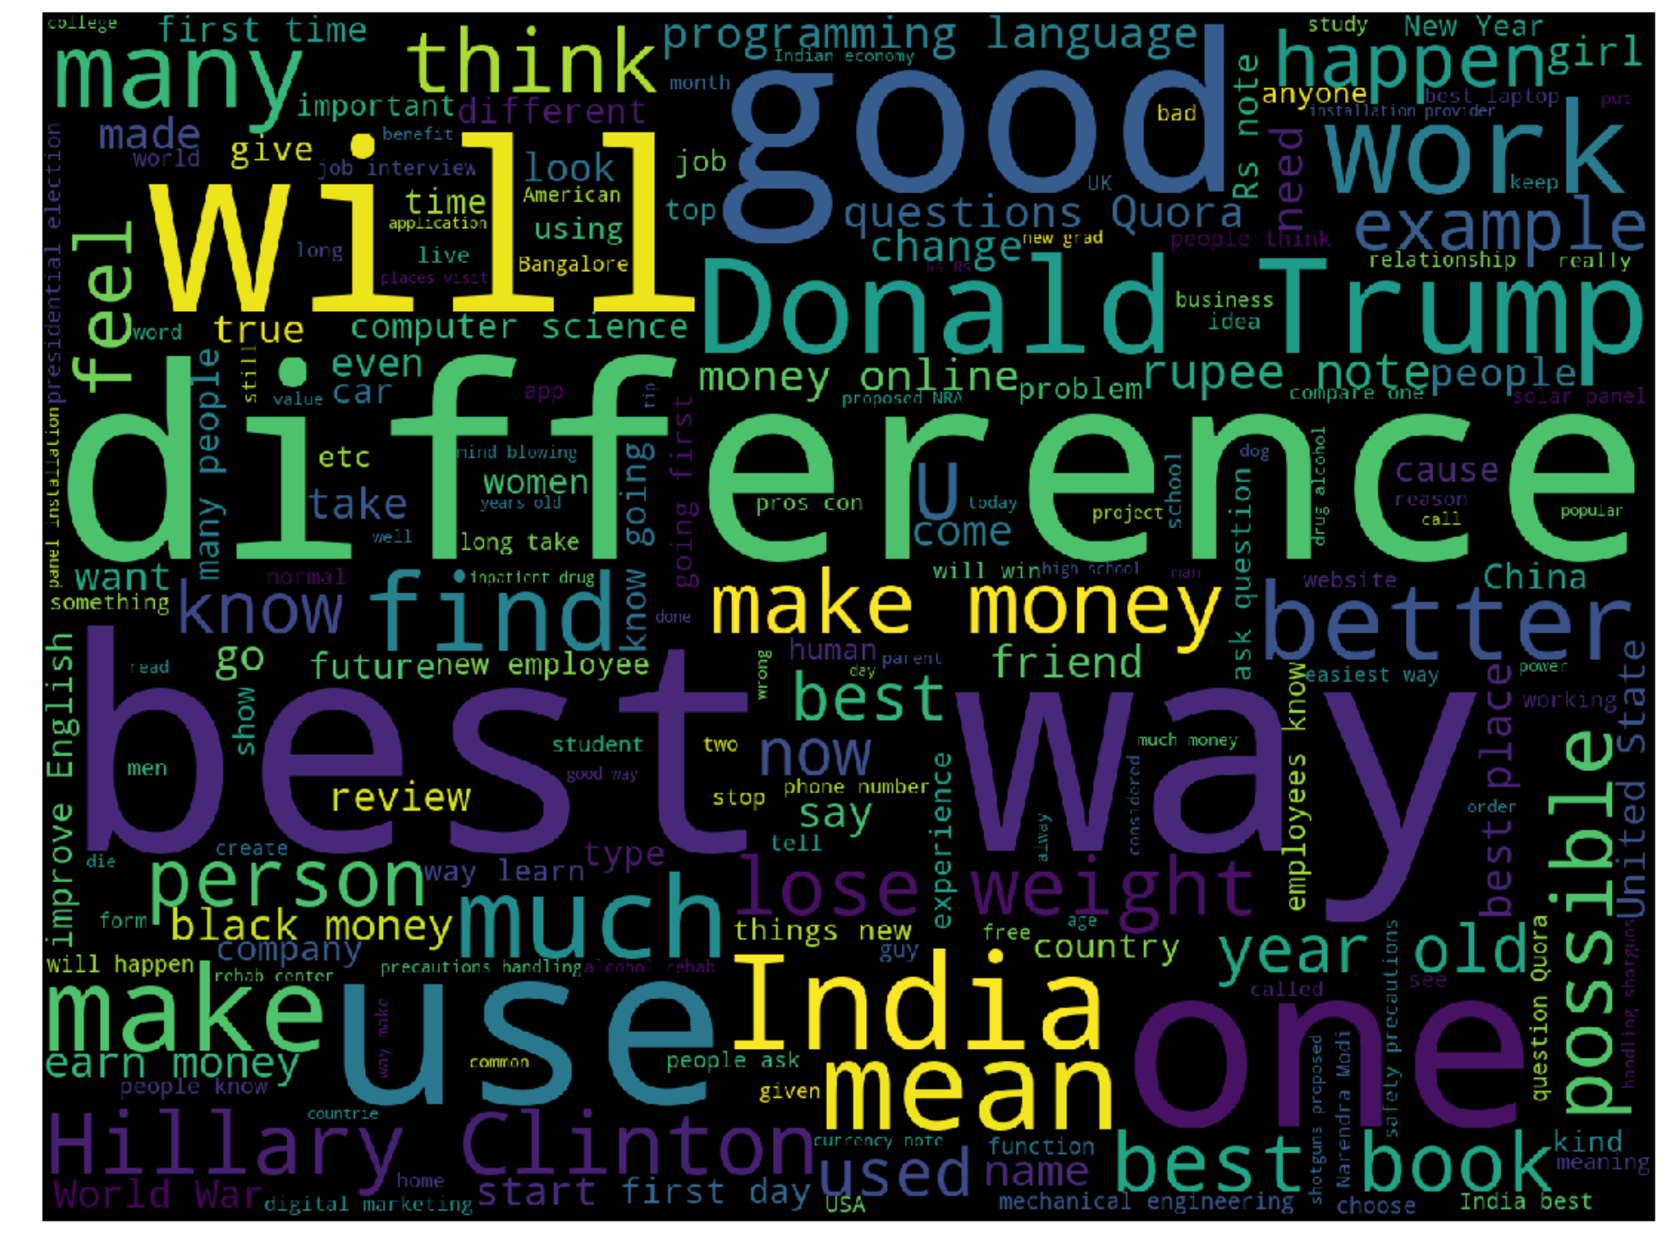
DATA OVERVIEW
What are the most common words?

Slide 8
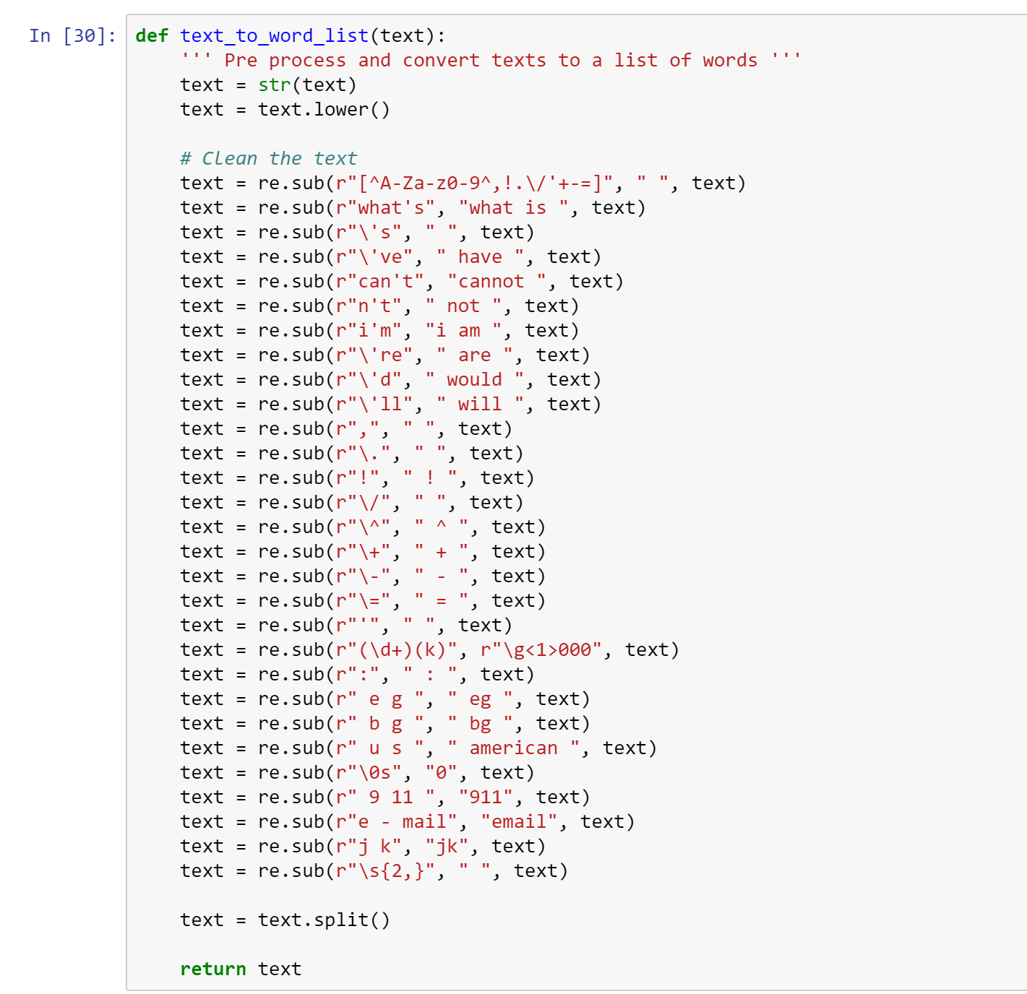
DATA CLEANING
Text Cleaning: convert all tokens to lower case, remove punctuations, special tokens, etc.
Text Normalization: Restore abbreviations (e.g. "What's" to "What is", "We're" to "We are", etc.) using regular expression, replace number-like string with "number" and replace currency symbols with "USD" abbreviation

Slide 9
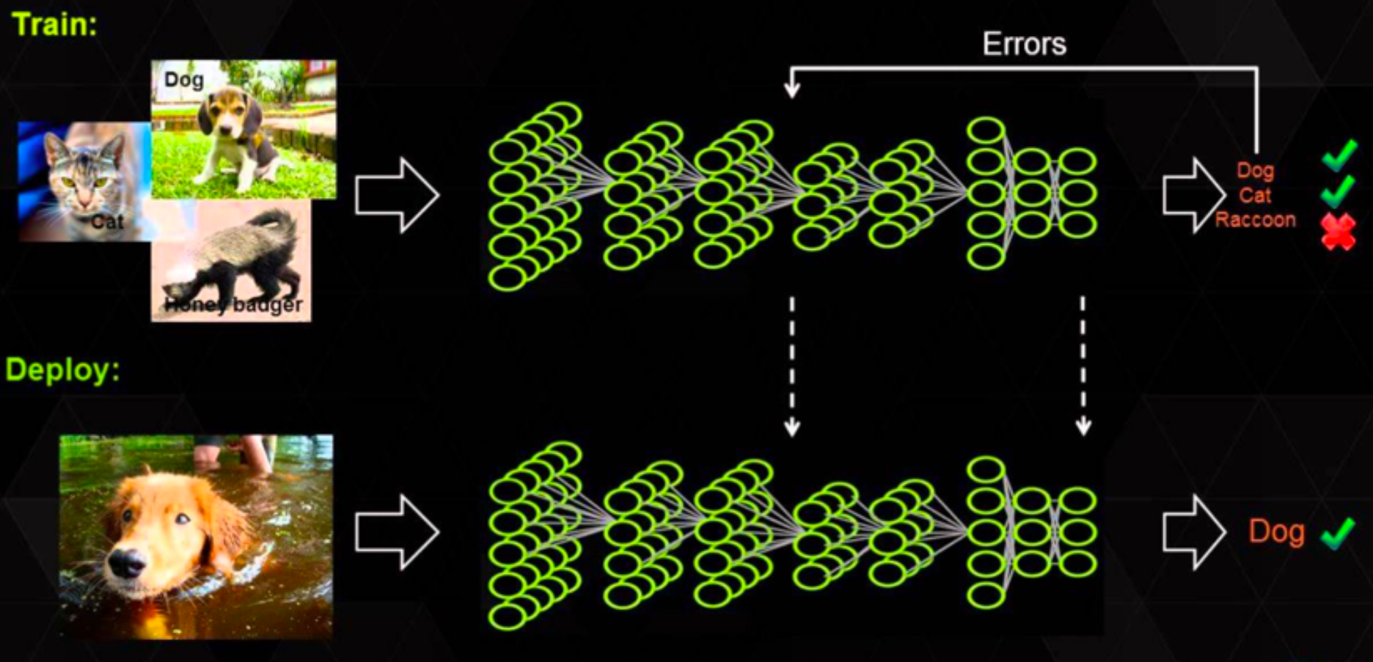
DEEP LEARNING APPROACH

Slide 10
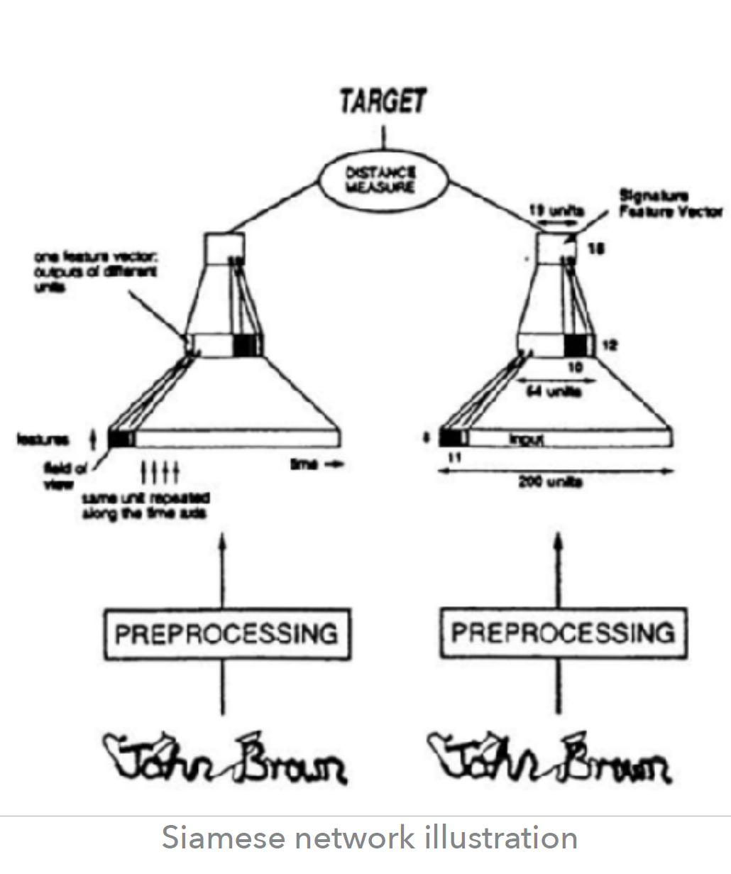
SIAMESE NEURAL NETWORK
Siamese Neural Network:
• Two or more parallel networks
• Same weights are trained with two inputs.
• Dense layer to connect the two nets
• MaLSTM (“Ma” for Manhattan distance)
• In MaLSTM the identical sub-network is all the way from the embedding up to the last LSTM hidden state.
Notes:
Siamese networks seem to perform well on similarity tasks and have been used for tasks like sentence semantic similarity, recognizing forged signatures and many more.

Slide 11
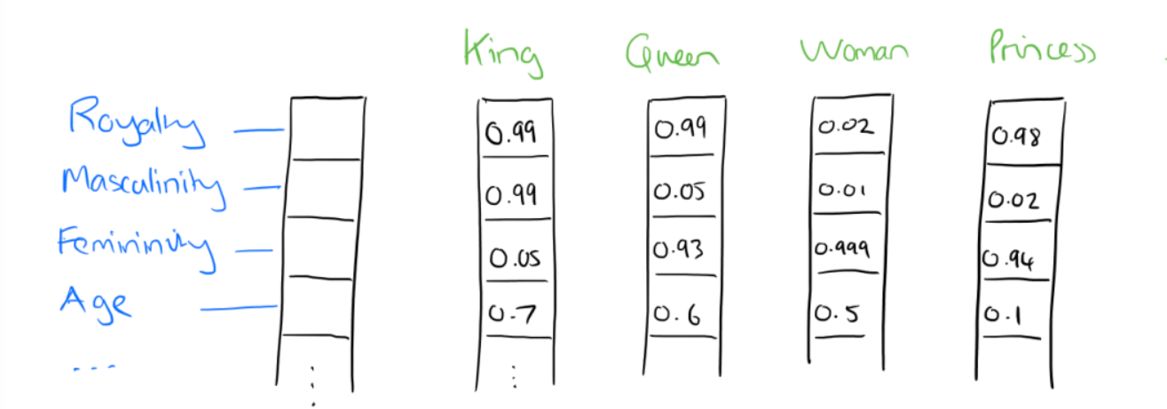
WORD EMBEDDING modern way to represent words in deep learning models
Embedding of each questions
Word2Vec, Doc2Vec, Sent2Vec
What is word embedding ?
• Projection of each word/document/sentence in a very high dimensional space
• In this space, each word is given coordinates such that words with common sense
are close one an other
‣ Python library Gensim, pre-trained by Google
‣ Allows the following: KING - MAN + WOMAN —> QUEEN
‣ Essentially it’s a method to give words semantic meaning in a vector representation.
Notes:
(we fixed dimension at 300)
If I label the dimensions in a hypothetical word vector (there are no such pre-assigned labels in the algorithm of course), it might look a bit like this:
Such a vector comes to represent in some abstract way the ‘meaning’ of a word.

Slide 12
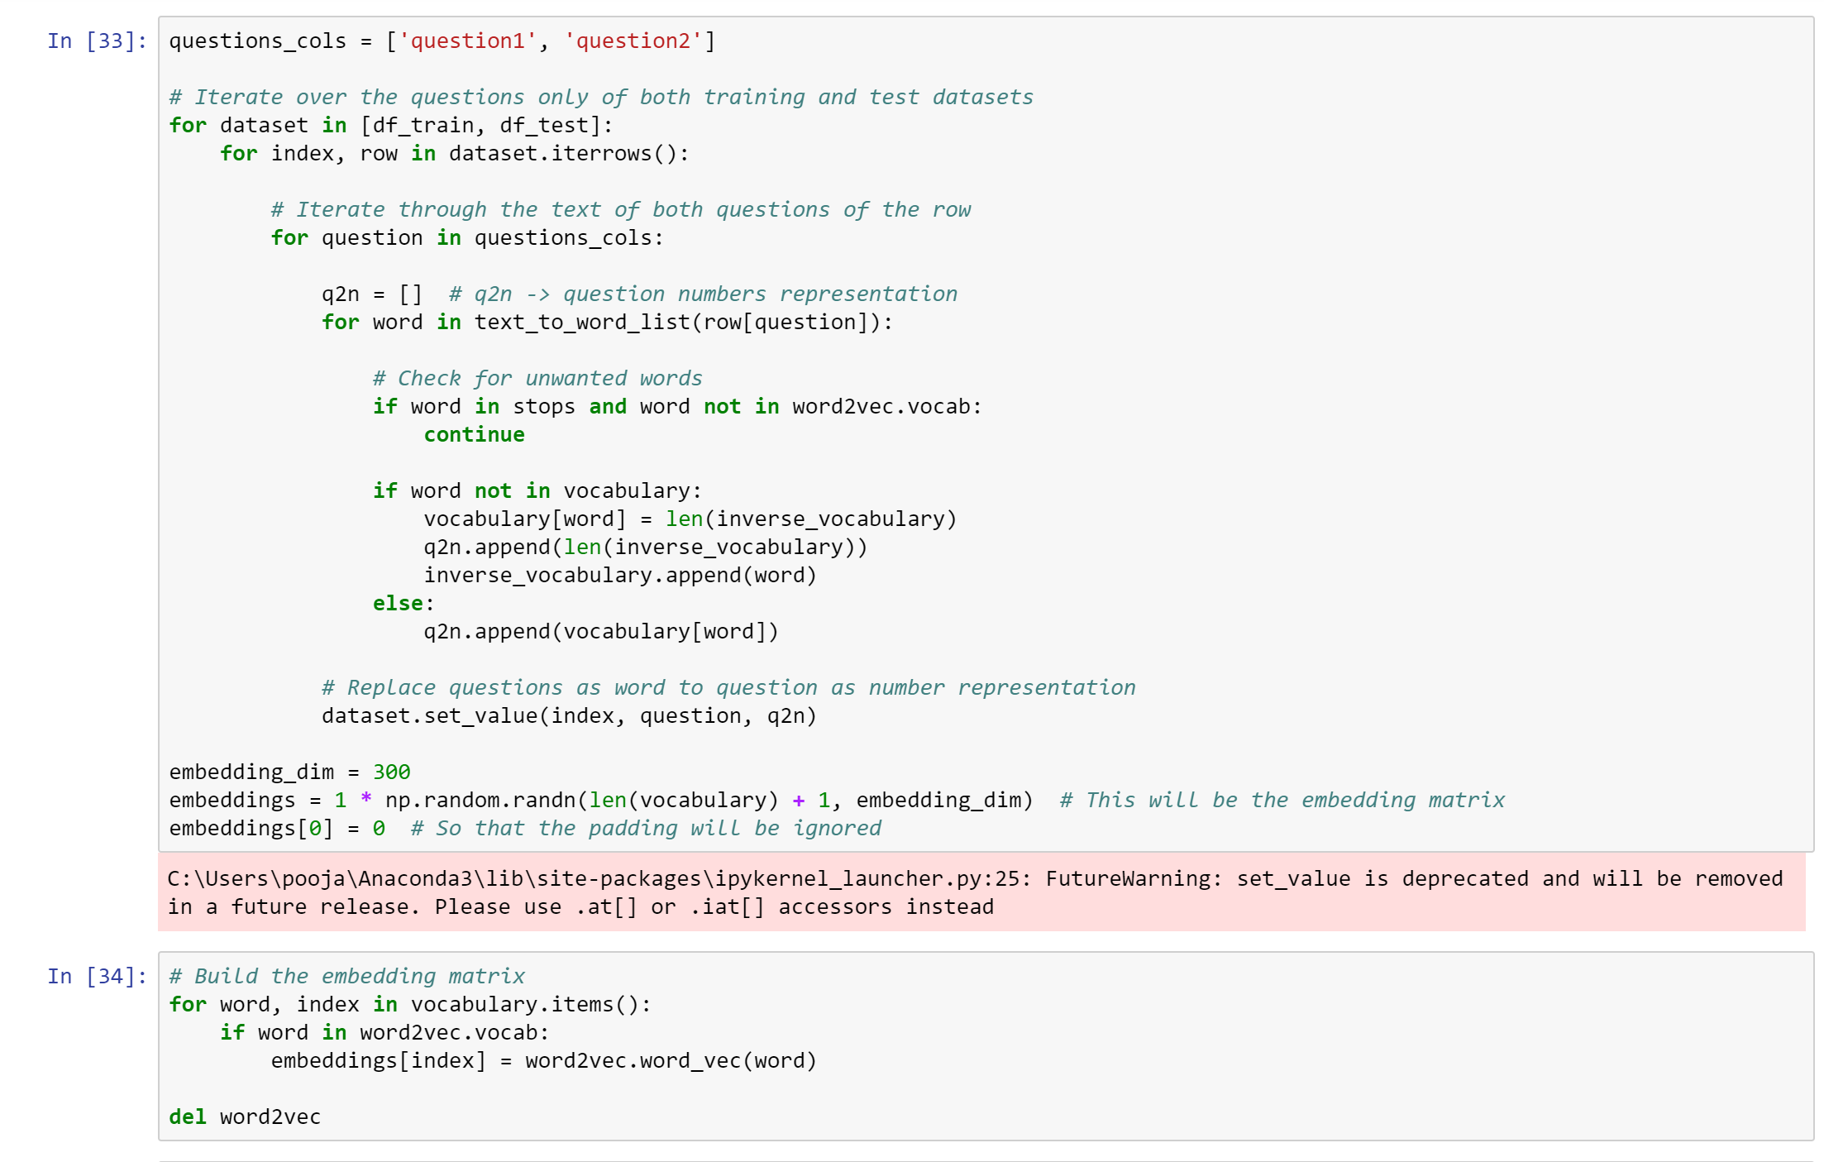
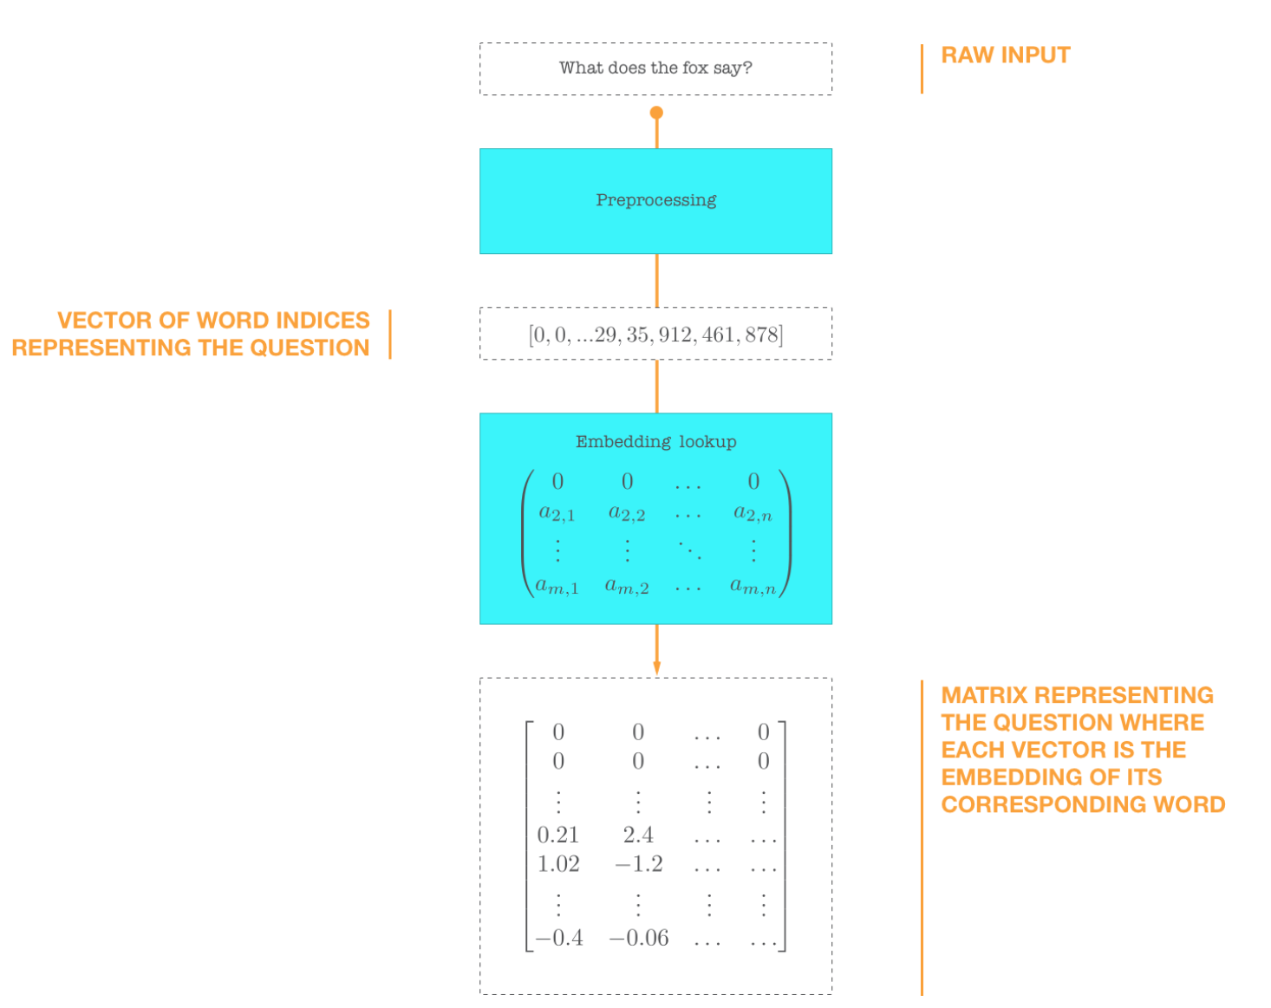
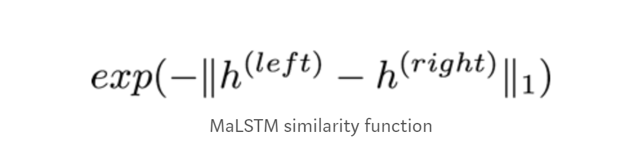
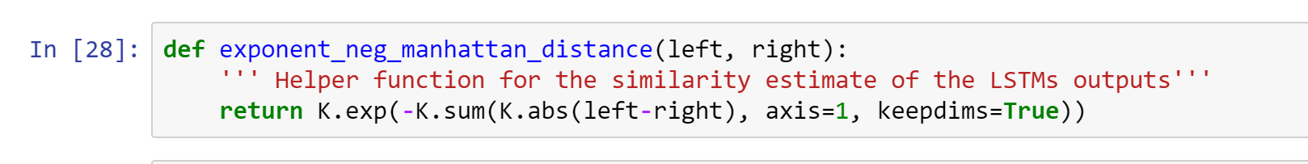
WORD EMBEDDING
Notes:
Inputs to the network are zero-padded sequences of word indices. These inputs are vectors of fixed length, where the first zeros are being ignored and the nonzeros are indices that uniquely identify words.Those vectors are then fed into the embedding layer. This layer looks up the corresponding embedding for each word and encapsulates all them into a matrix. This matrix represents the given text as a series of embeddings.I use Google’s word2vec embedding
We have two embedded matrices that represent a candidate of two similar questions. Then we feed them into the LSTM (practically, there is only one) and the final state of the LSTM for each question is a 50-dimensional vector. It is trained to capture semantic meaning of the question. In figure 1, this vector is denoted by the letter h.

Slide 13
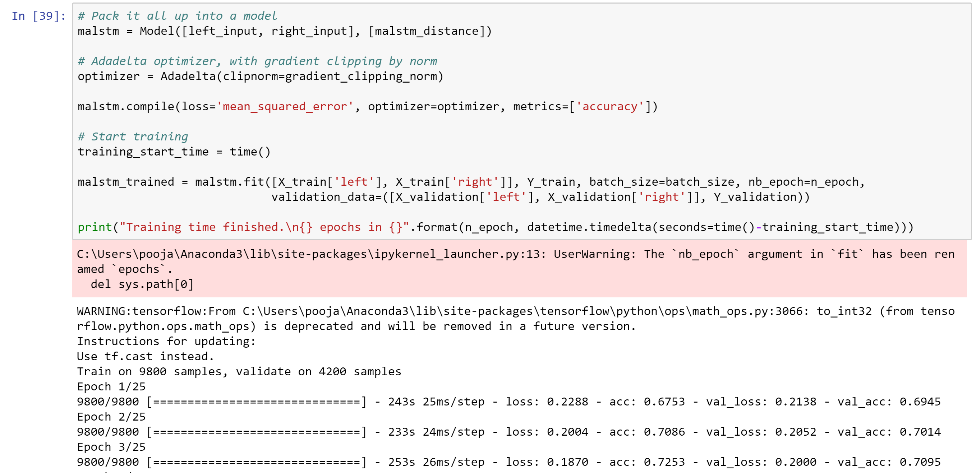
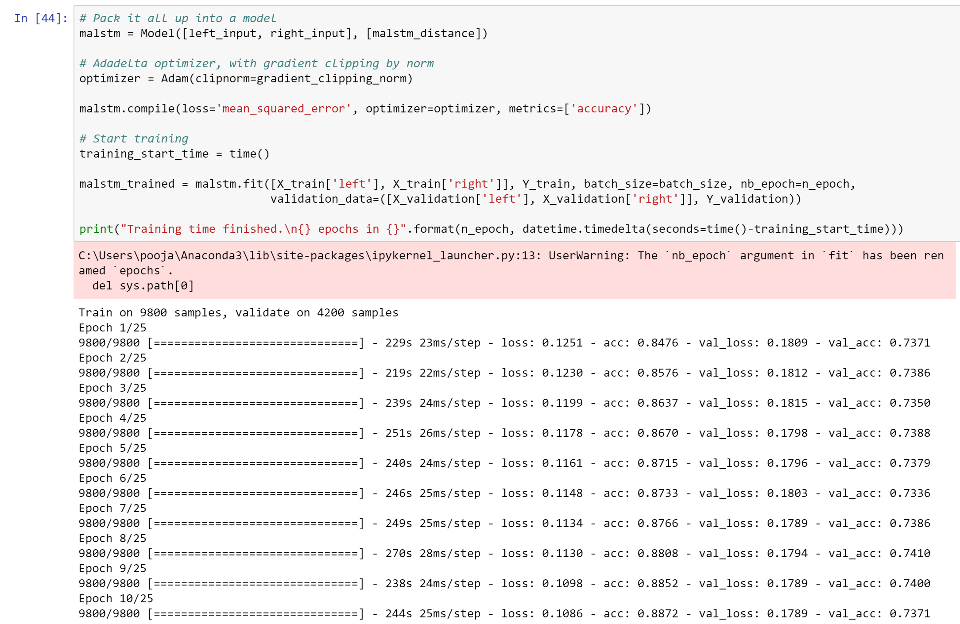
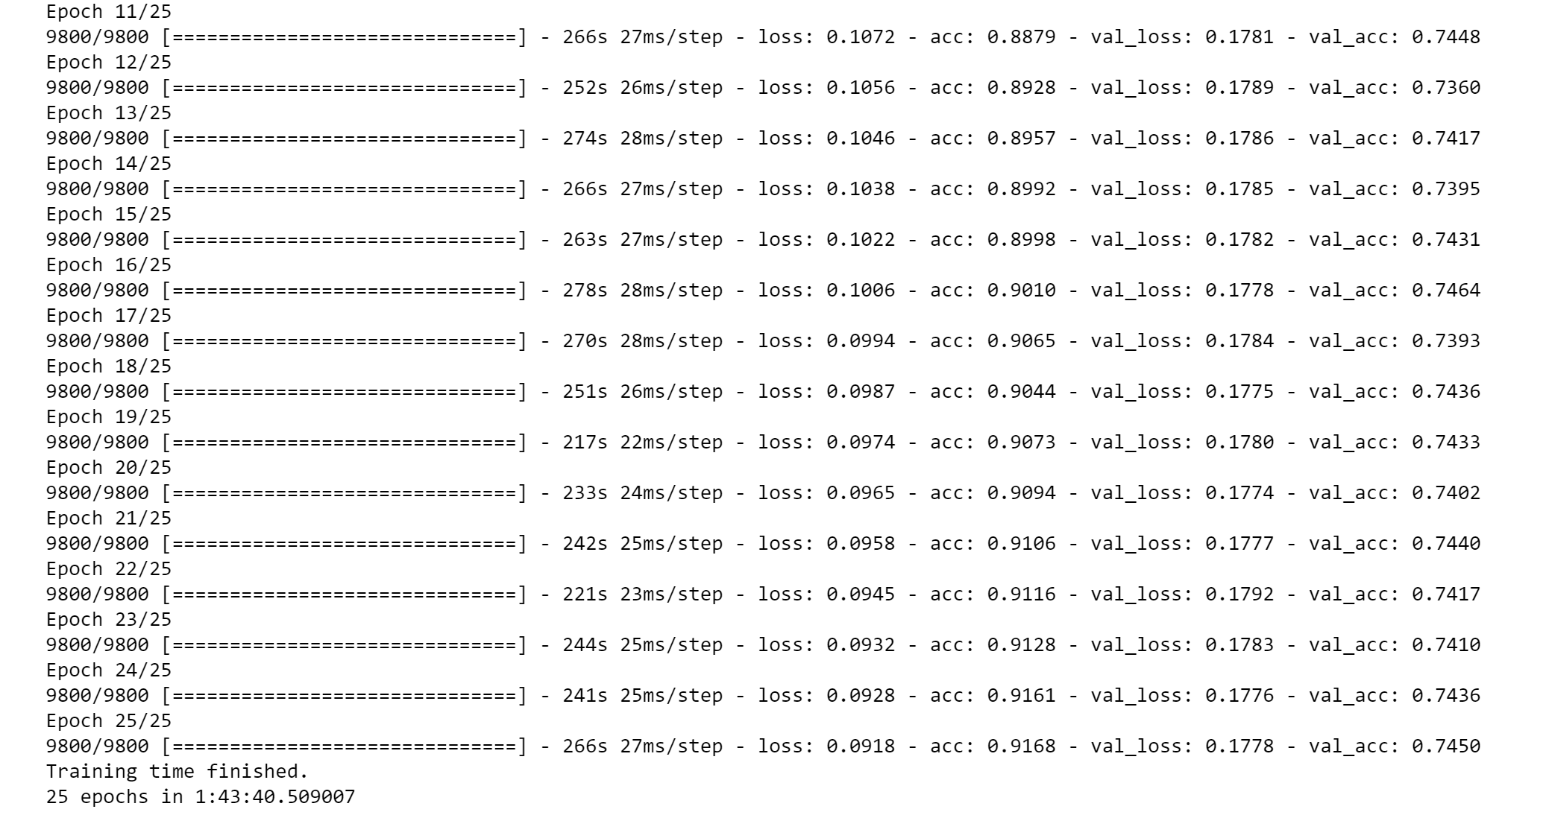
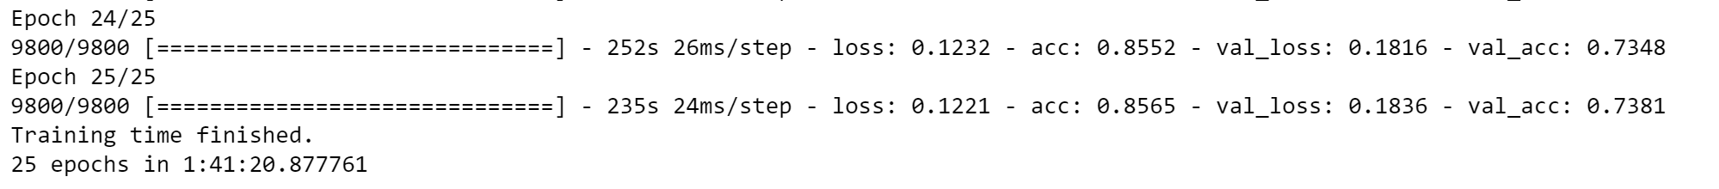
OPTIMIZERS

Slide 14
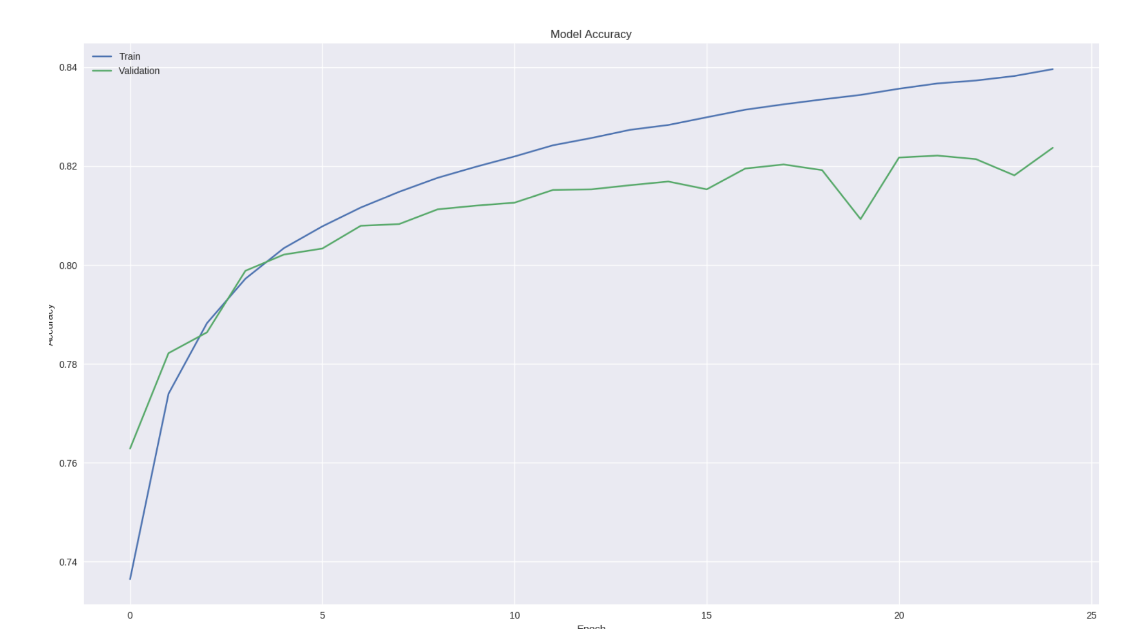
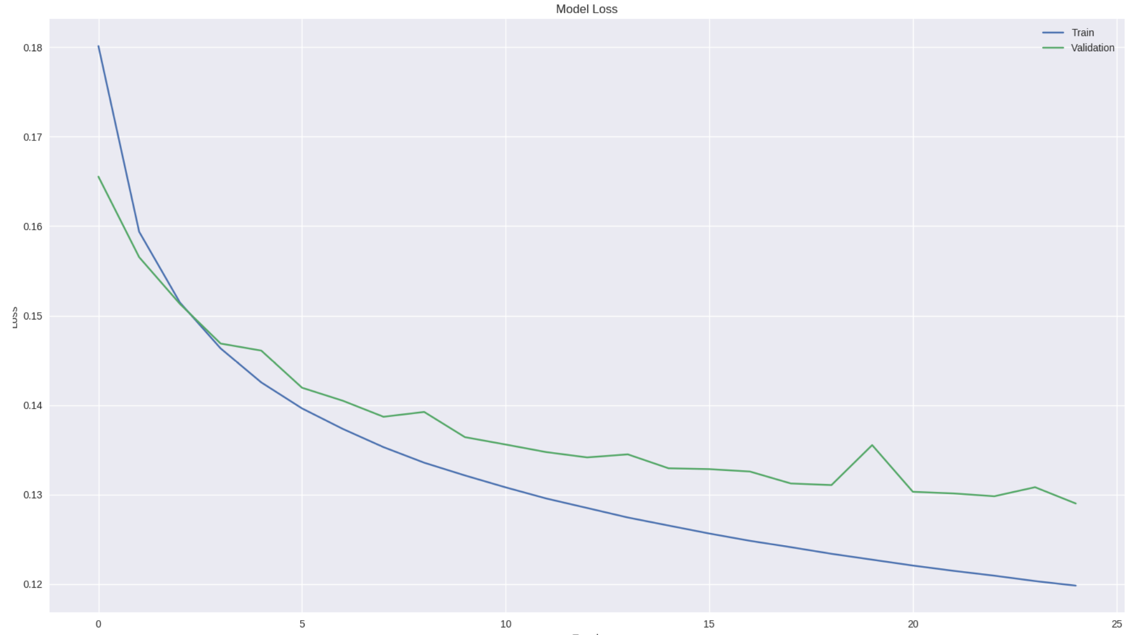
ACCURACY & LOSS

Slide 15
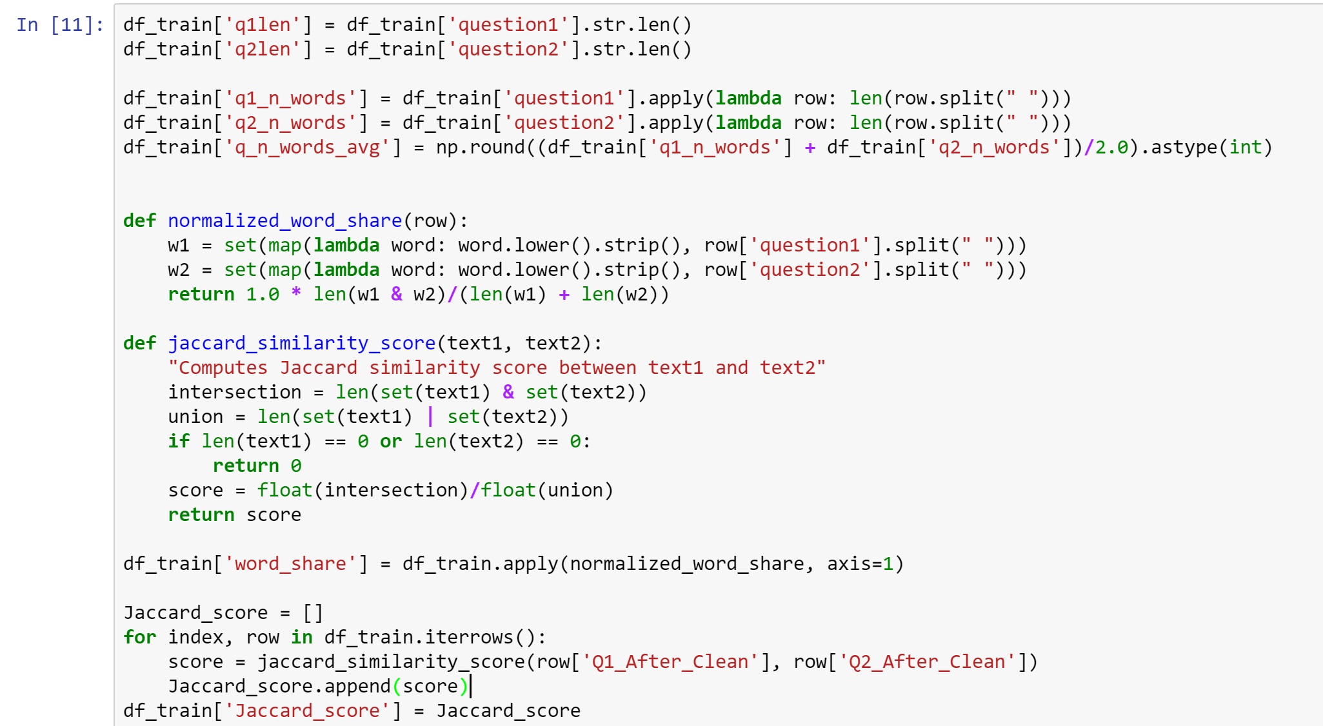
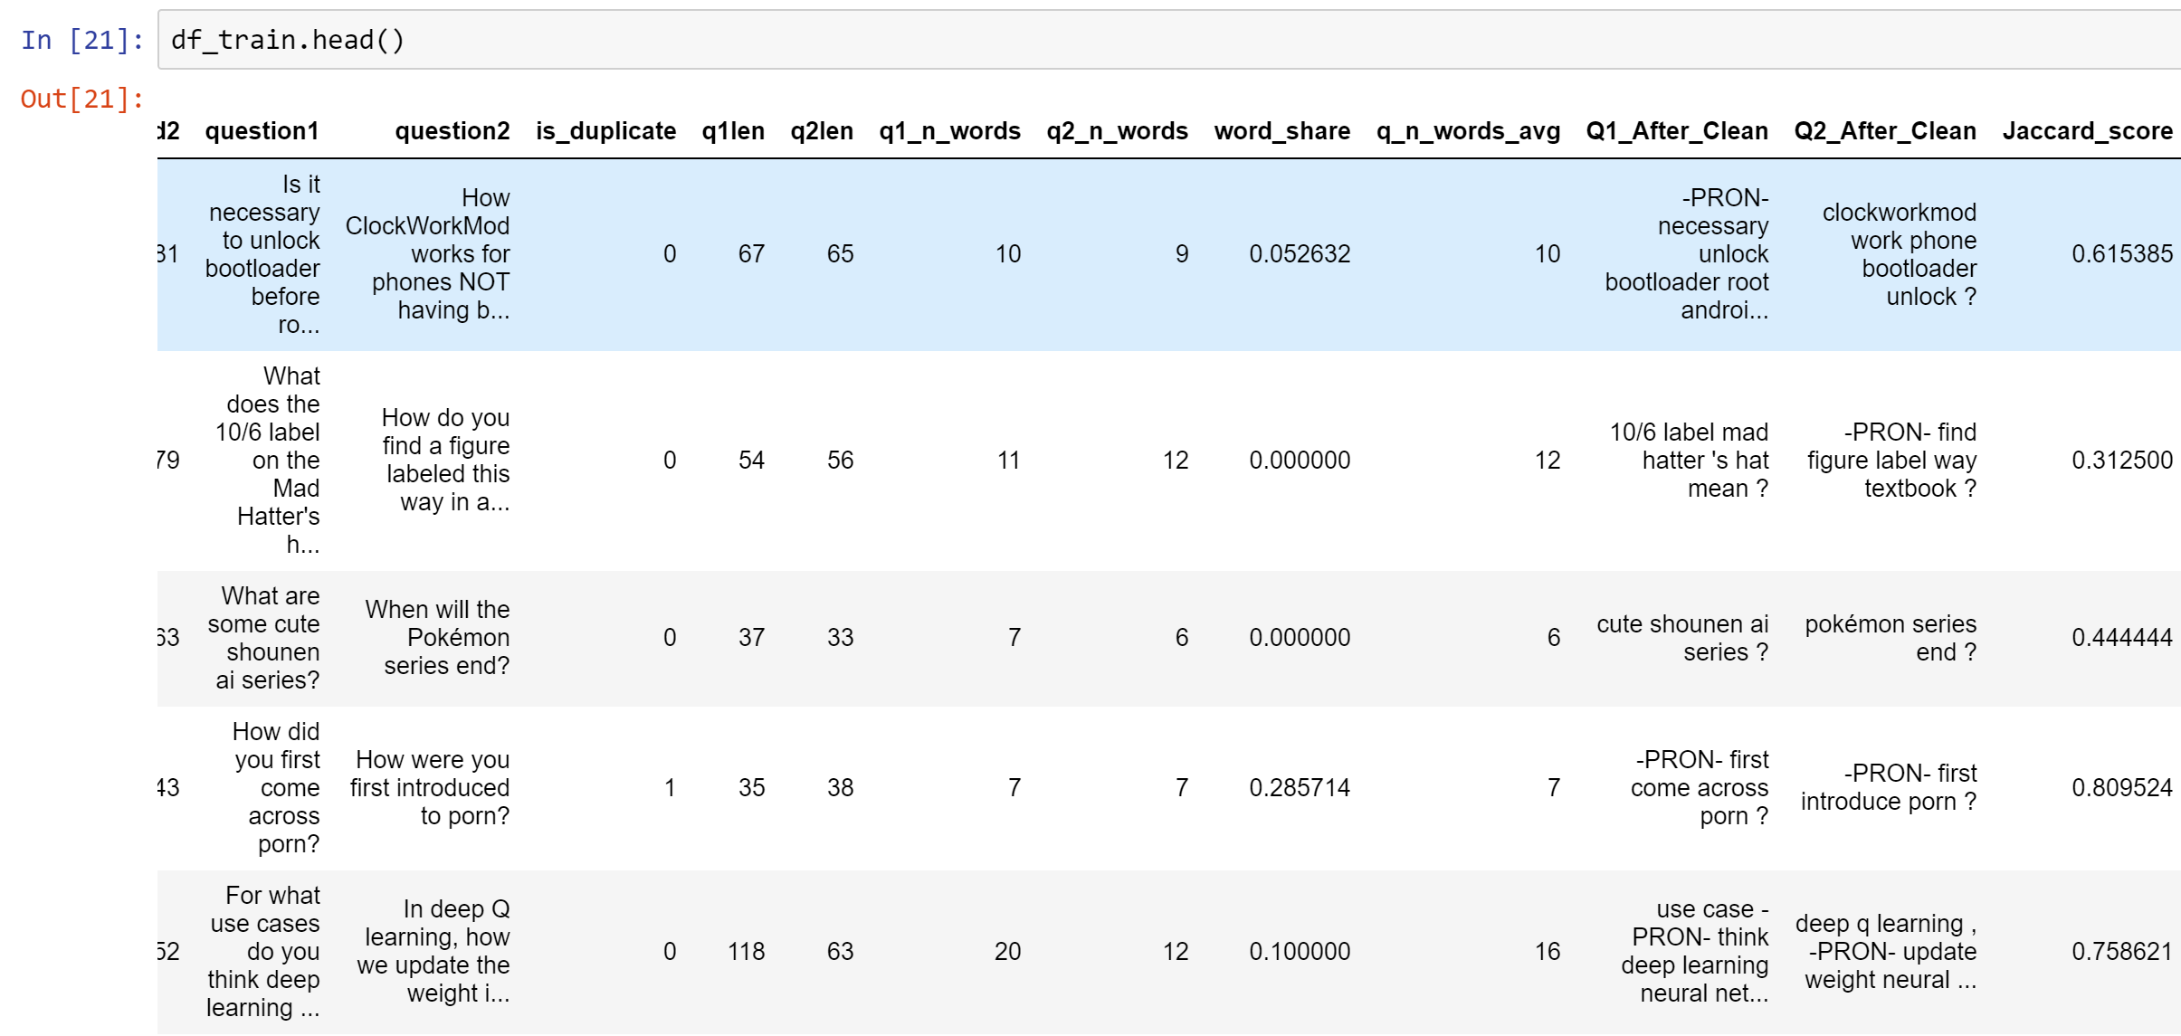
NATURAL LANGUAGE PROCESSING
NLP Features: text-based features
Character length of questions 1 and 2
Number of words in question 1 and 2
Average Number of Words in both questions for each row
Normalized Word Share Count
Jaccard Similarity
Notes:
I tried going ahead with tfidf scores, but that was not very useful and computationally expensive

Slide 16
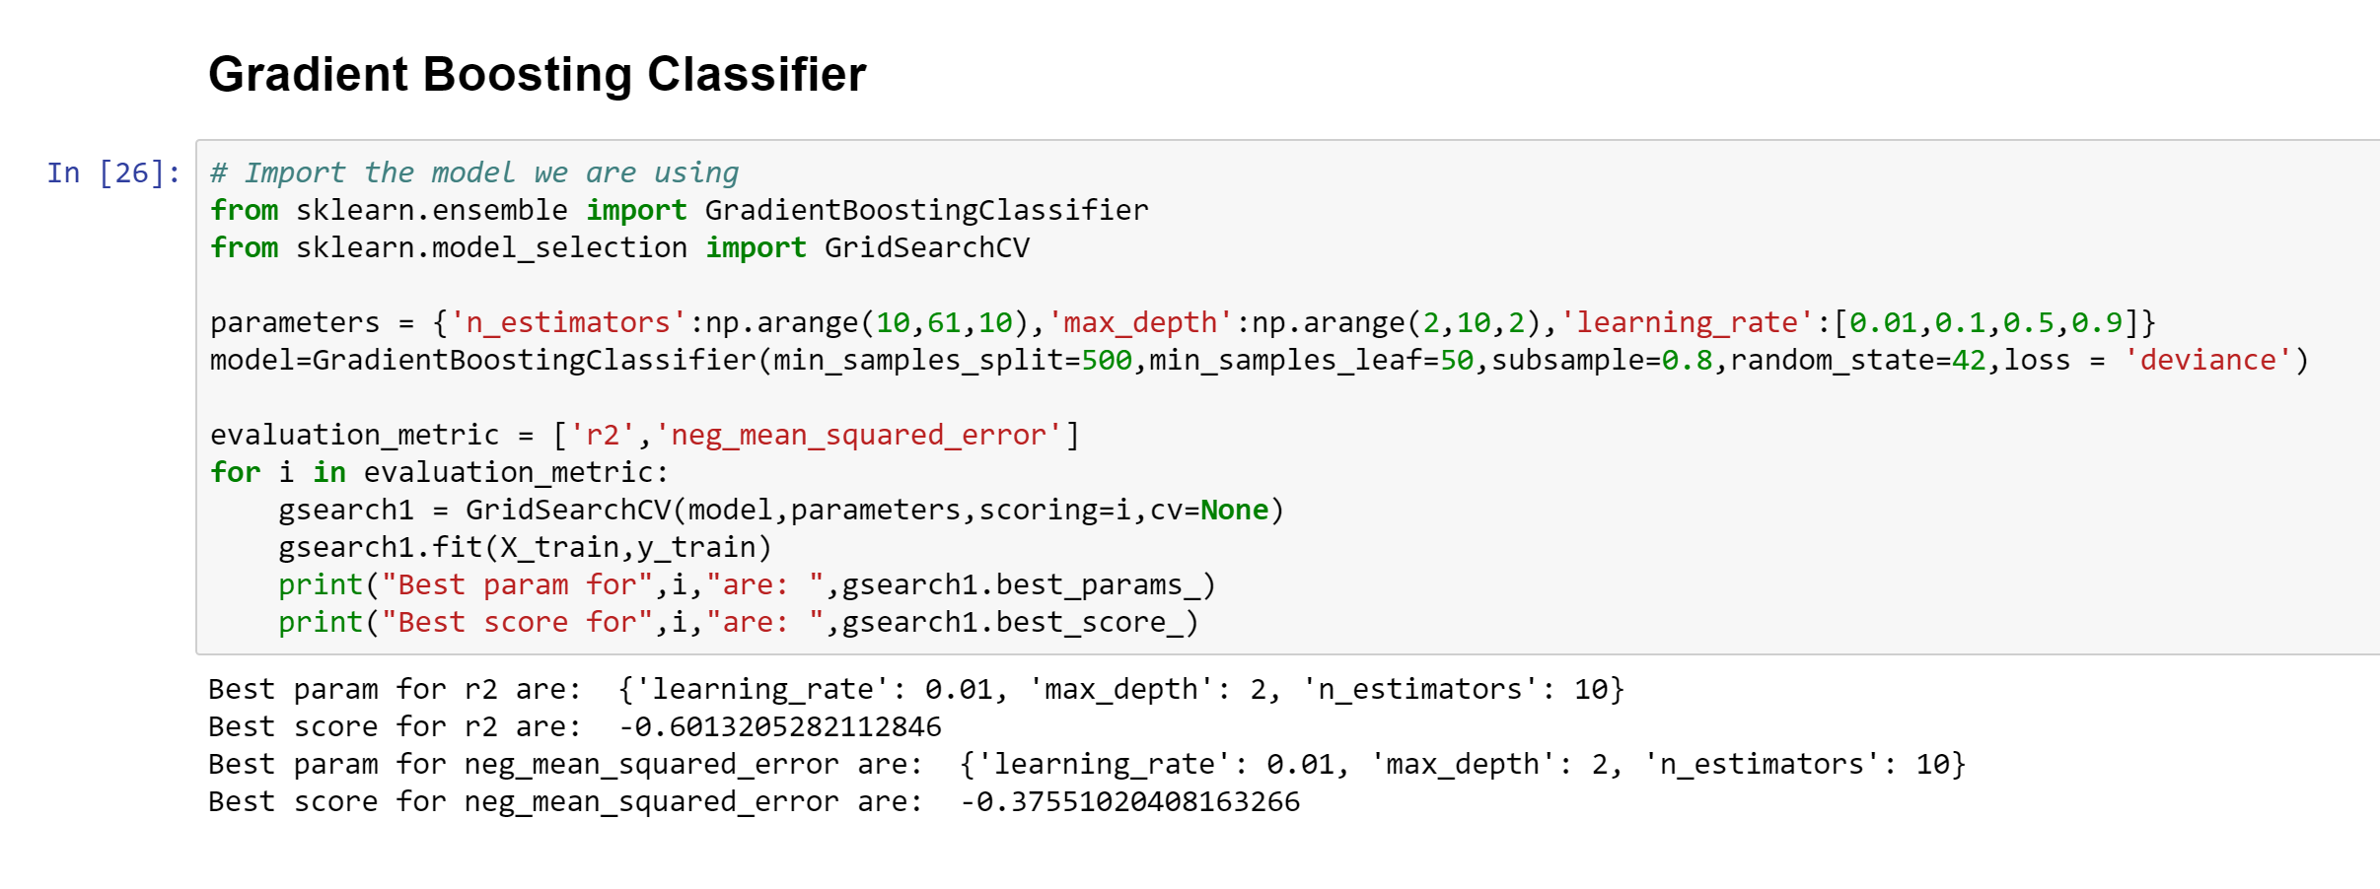
FEATURE SCALE & GRID SEARCH

Slide 17
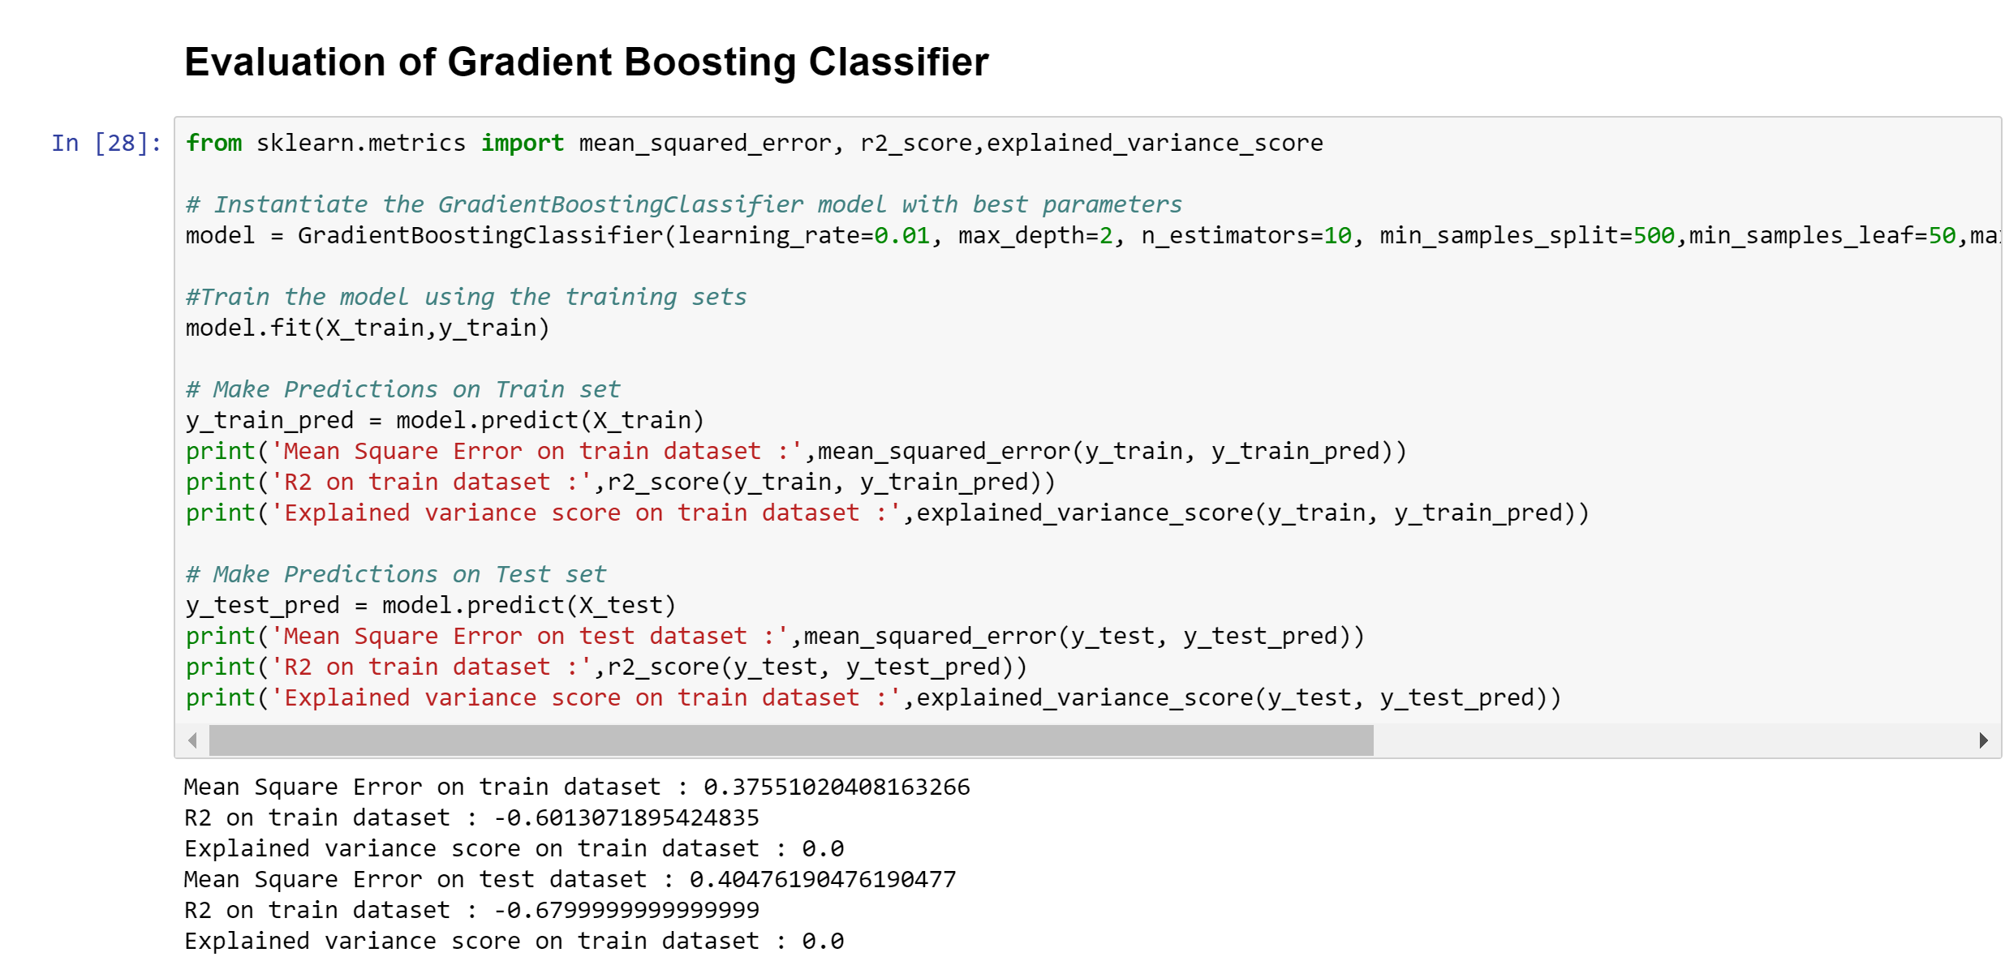
EVALUATION

Slide 18
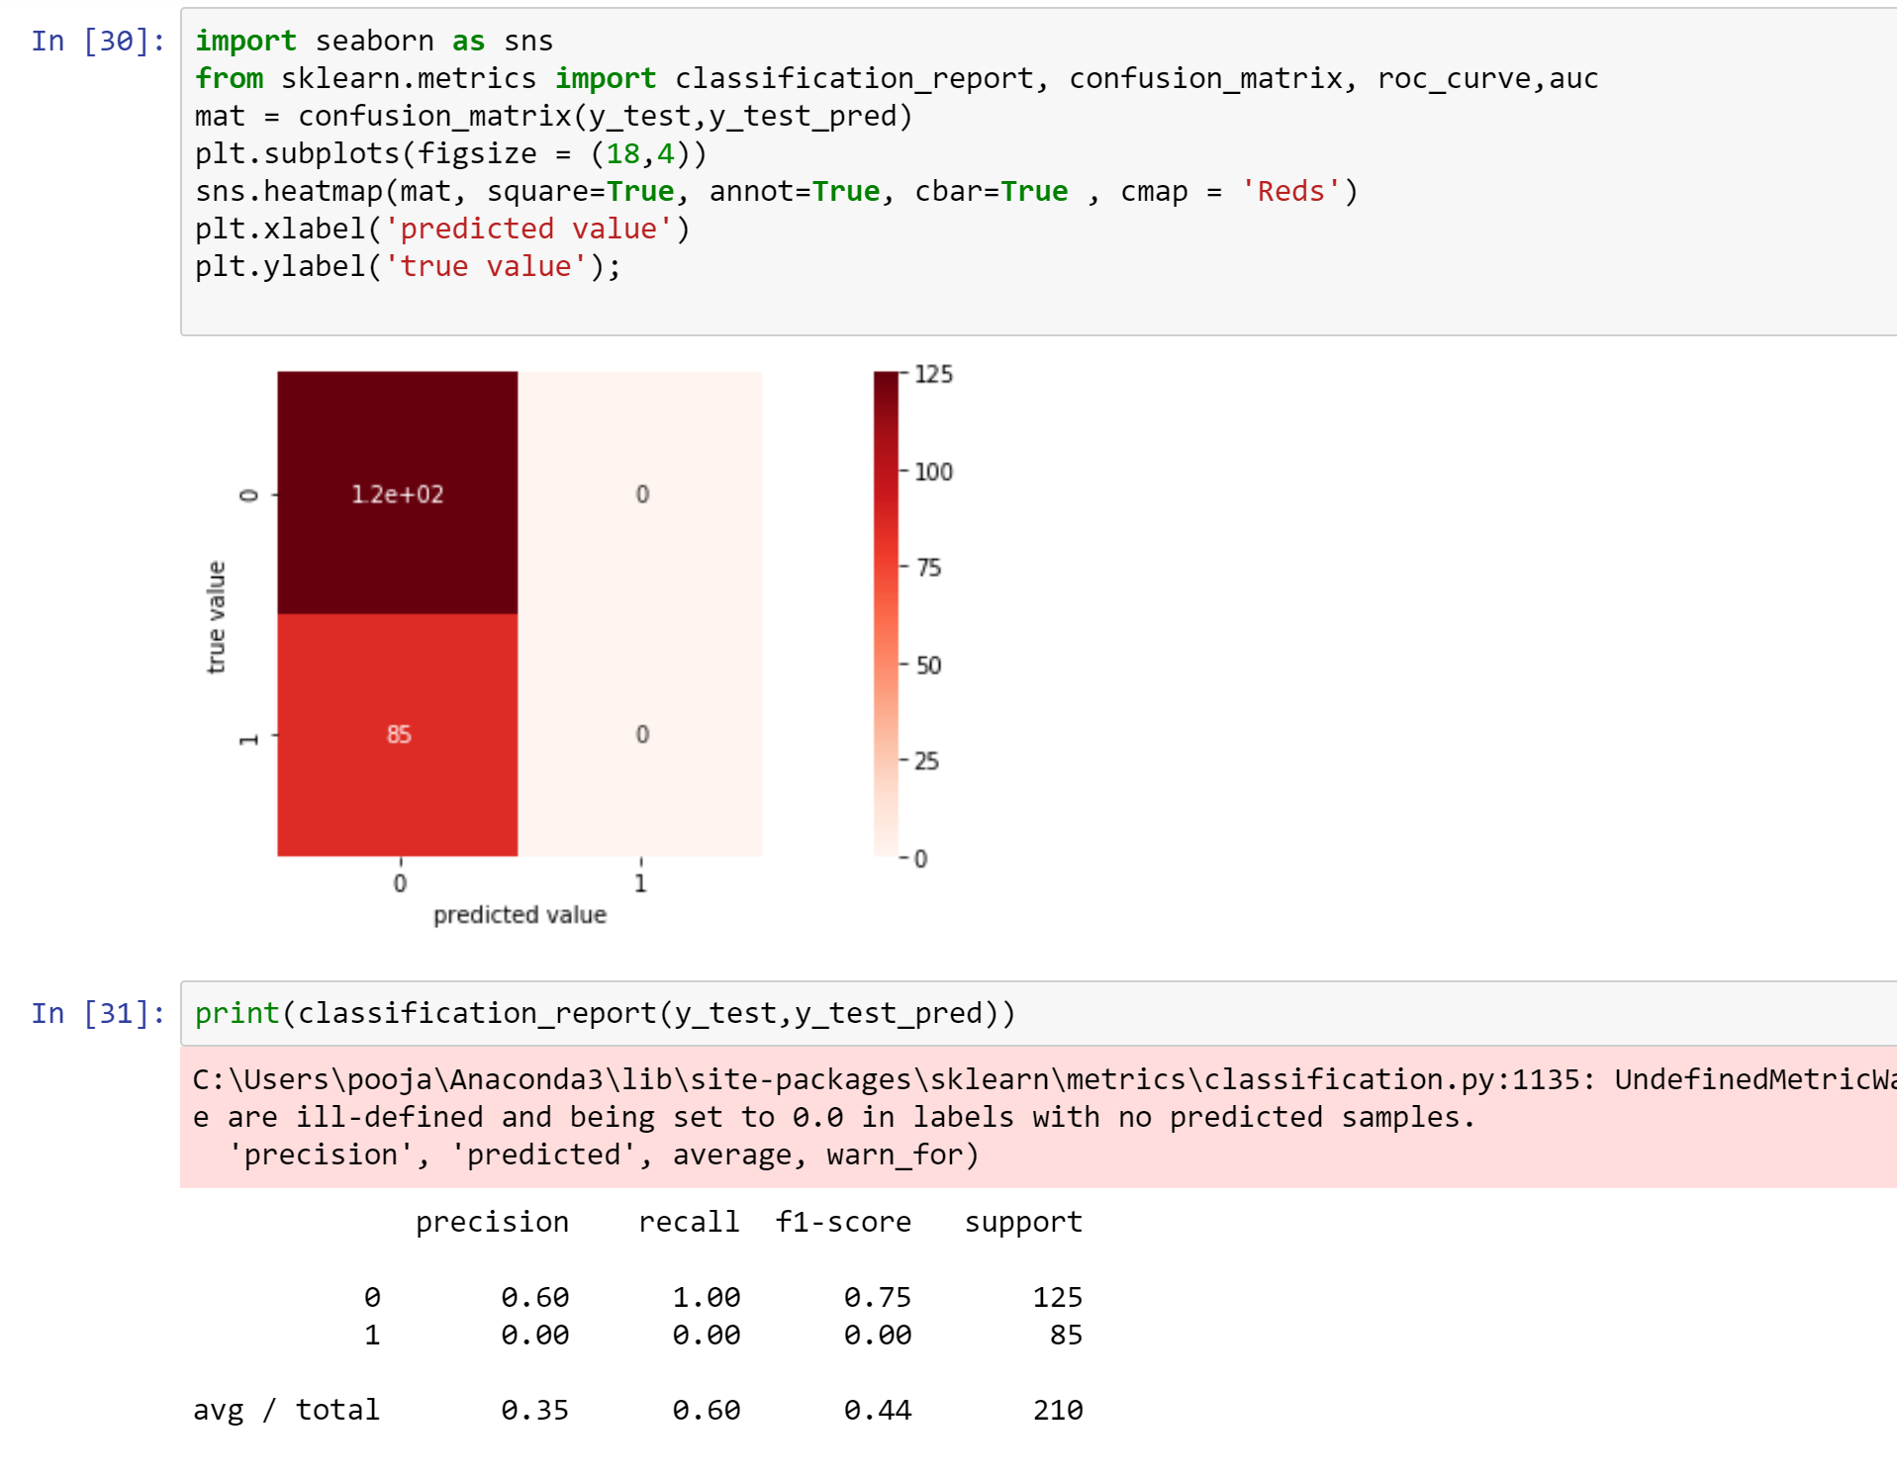
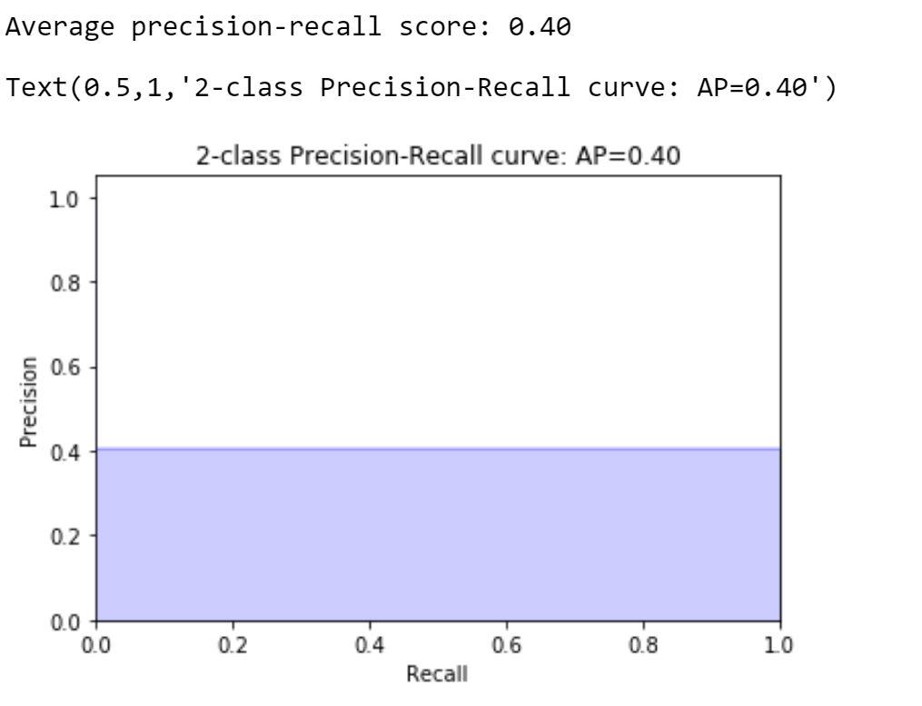
EVALUATION

Slide 19
CONCLUSION
▸ It’s a huge dataset and took a lot of time in processing and building models
▸State of the art – deep learning model is giving good prediction
▸ A stacker with hundreds of models, with a reusable pipeline for model building will definitely be the best solution
▸ What’s interesting for Quora is the way we analyzed their data, giving them a lot of insight for their own projects.

Slide 20
TOOLS USED
We use several popular NLP tools to help us achieve several necessary NLP tasks:
SpaCy
Word2Vec
Keras
Scikit-learn
GridSearch
GradientBoosting
Notes:
SpaCy: An industrial-strength python based NLP tool, mainy provide some useful functionalities, such as tokenizing, part-of-speech tagging, dependecy parsing, entity recognition, etc.
Textacy: Provide High-level APIs of Spacy, mainly for text normalization.
Scikit-learn: Python-based machine learning library. We used it for extracting latent semantic features and some of its simple models in blending.
Word2Vec, GloVe, FastText: Those are neural-based word embeddings, which represent a word as a real-valued dense vector. It captures nice syntatic and semantic properties in vector space. We used them for feature engineering and modeling.
Keras: High-level deep learning library, which made us easy to implement complex deep learning models.
XGBoost: An optimized distributed gradient boosting library. This offers another kind of non-deep-learning models for us to perform ensembling.

Slide 21
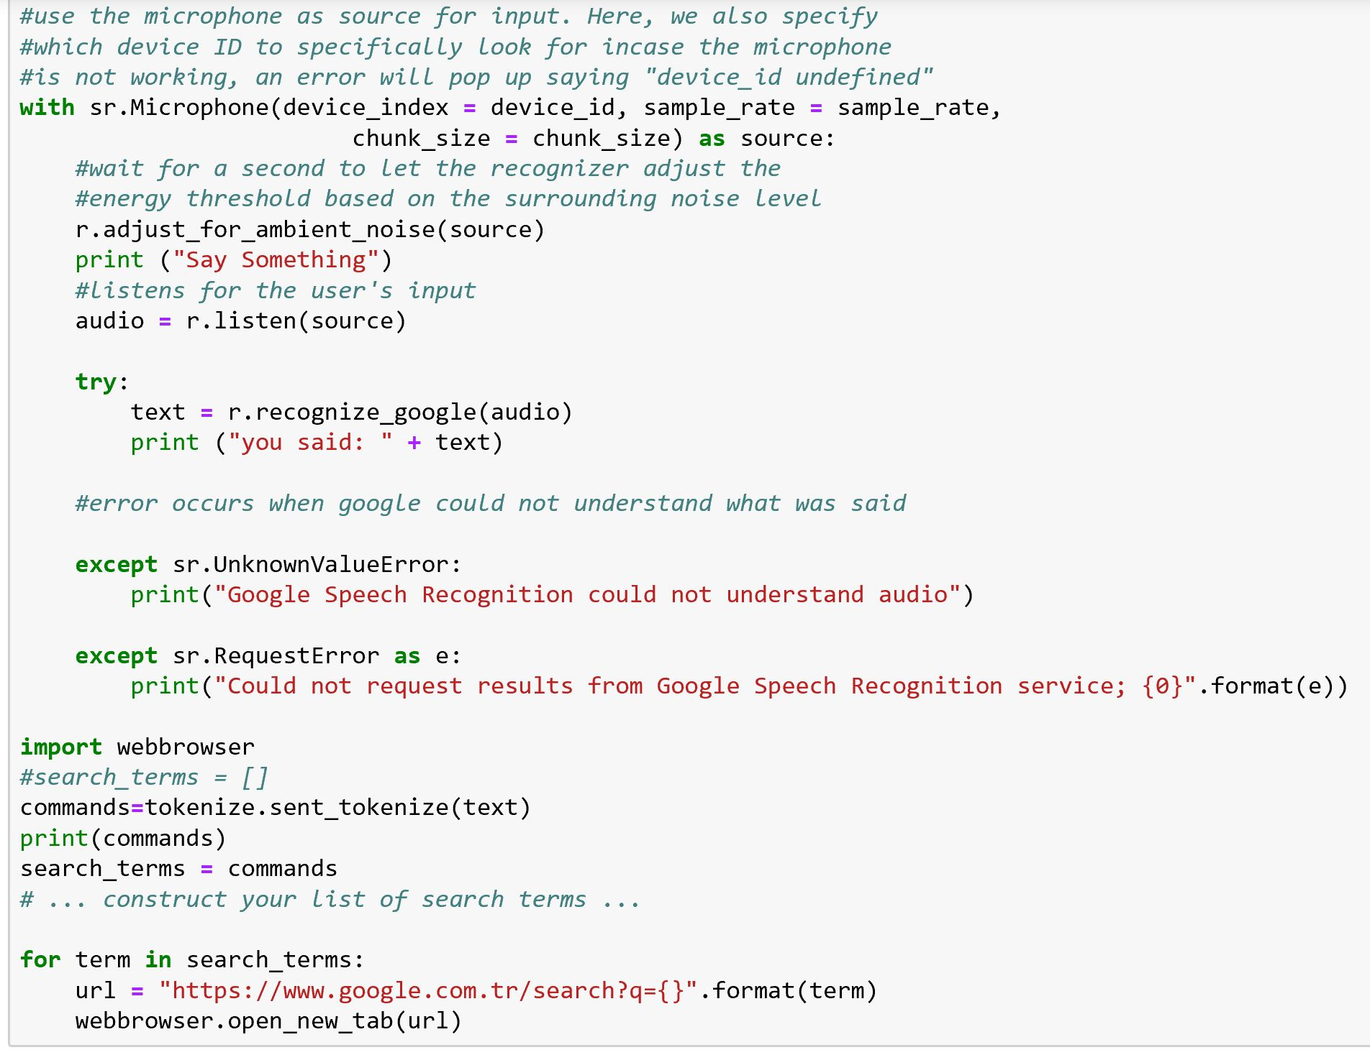
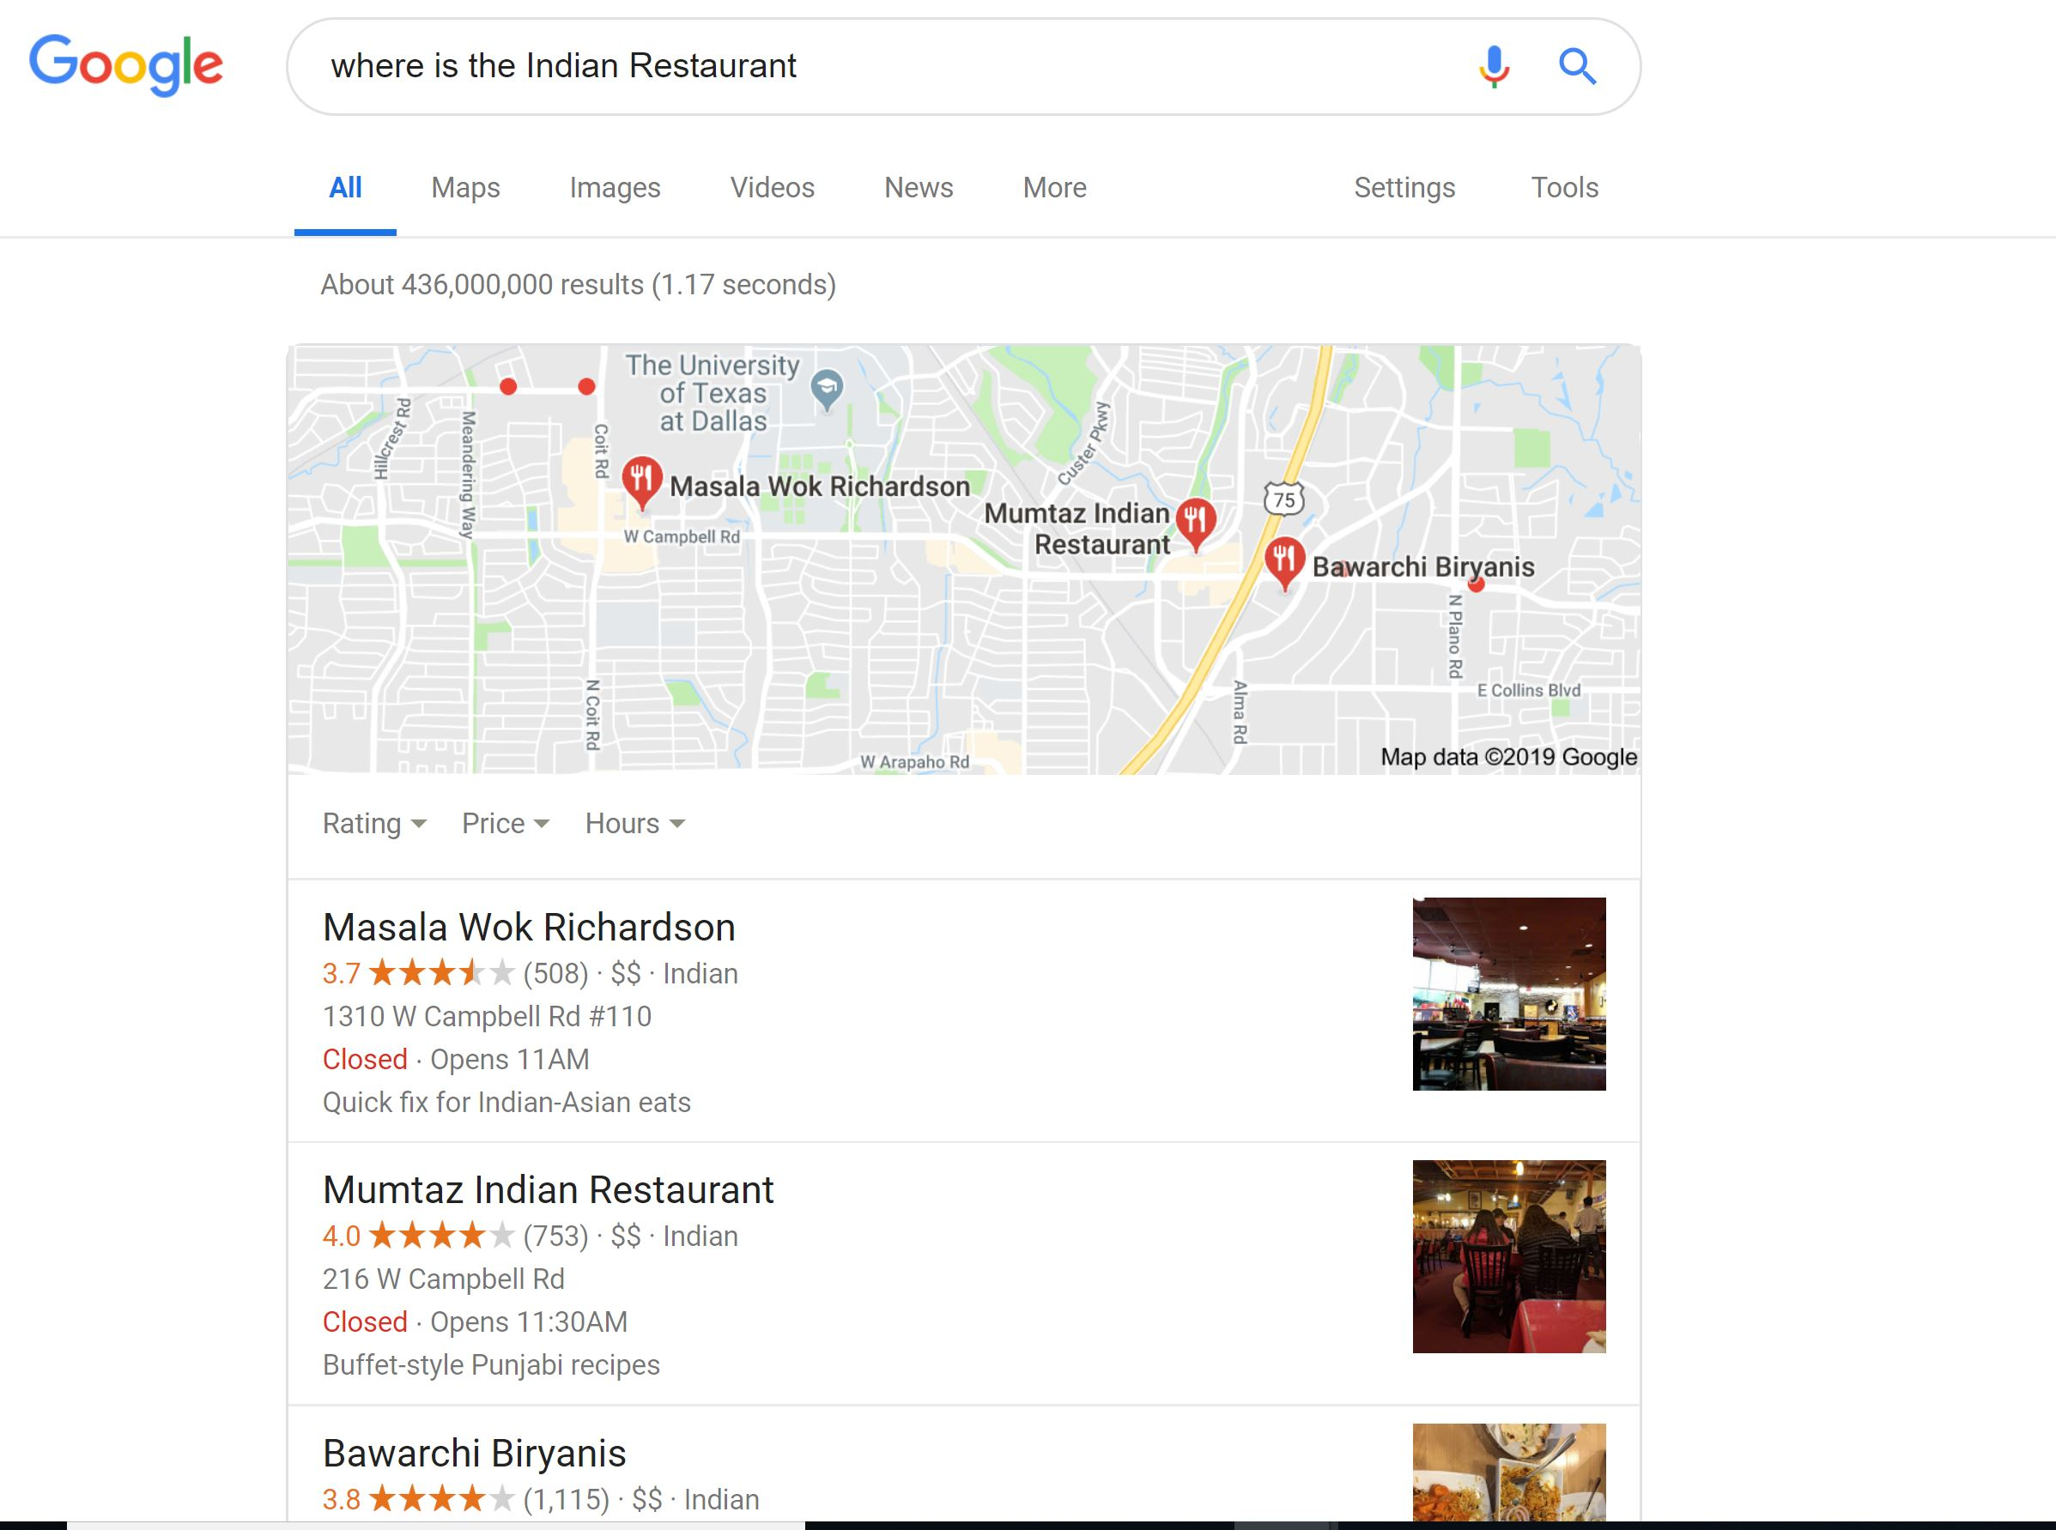
Speech Recognition
Speech Recognition
Speech Recognition
Google Simple Search
Notes:
SpaCy: An industrial-strength python based NLP tool, mainy provide some useful functionalities, such as tokenizing, part-of-speech tagging, dependecy parsing, entity recognition, etc.
Textacy: Provide High-level APIs of Spacy, mainly for text normalization.
Scikit-learn: Python-based machine learning library. We used it for extracting latent semantic features and some of its simple models in blending.
Word2Vec, GloVe, FastText: Those are neural-based word embeddings, which represent a word as a real-valued dense vector. It captures nice syntatic and semantic properties in vector space. We used them for feature engineering and modeling.
Keras: High-level deep learning library, which made us easy to implement complex deep learning models.
XGBoost: An optimized distributed gradient boosting library. This offers another kind of non-deep-learning models for us to perform ensembling.

Slide 22
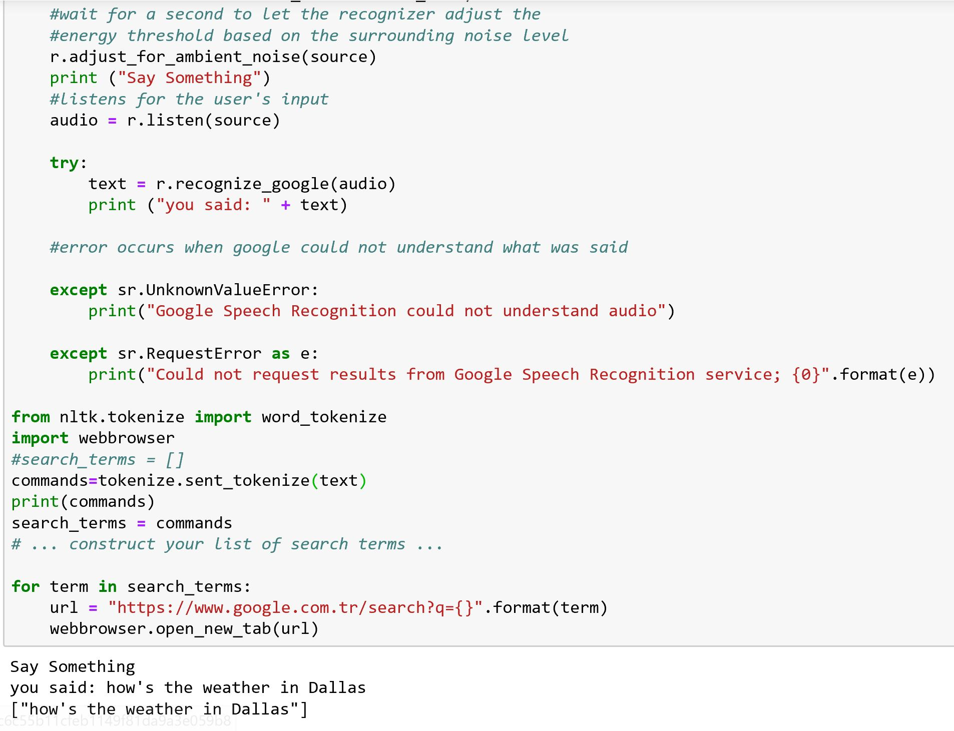
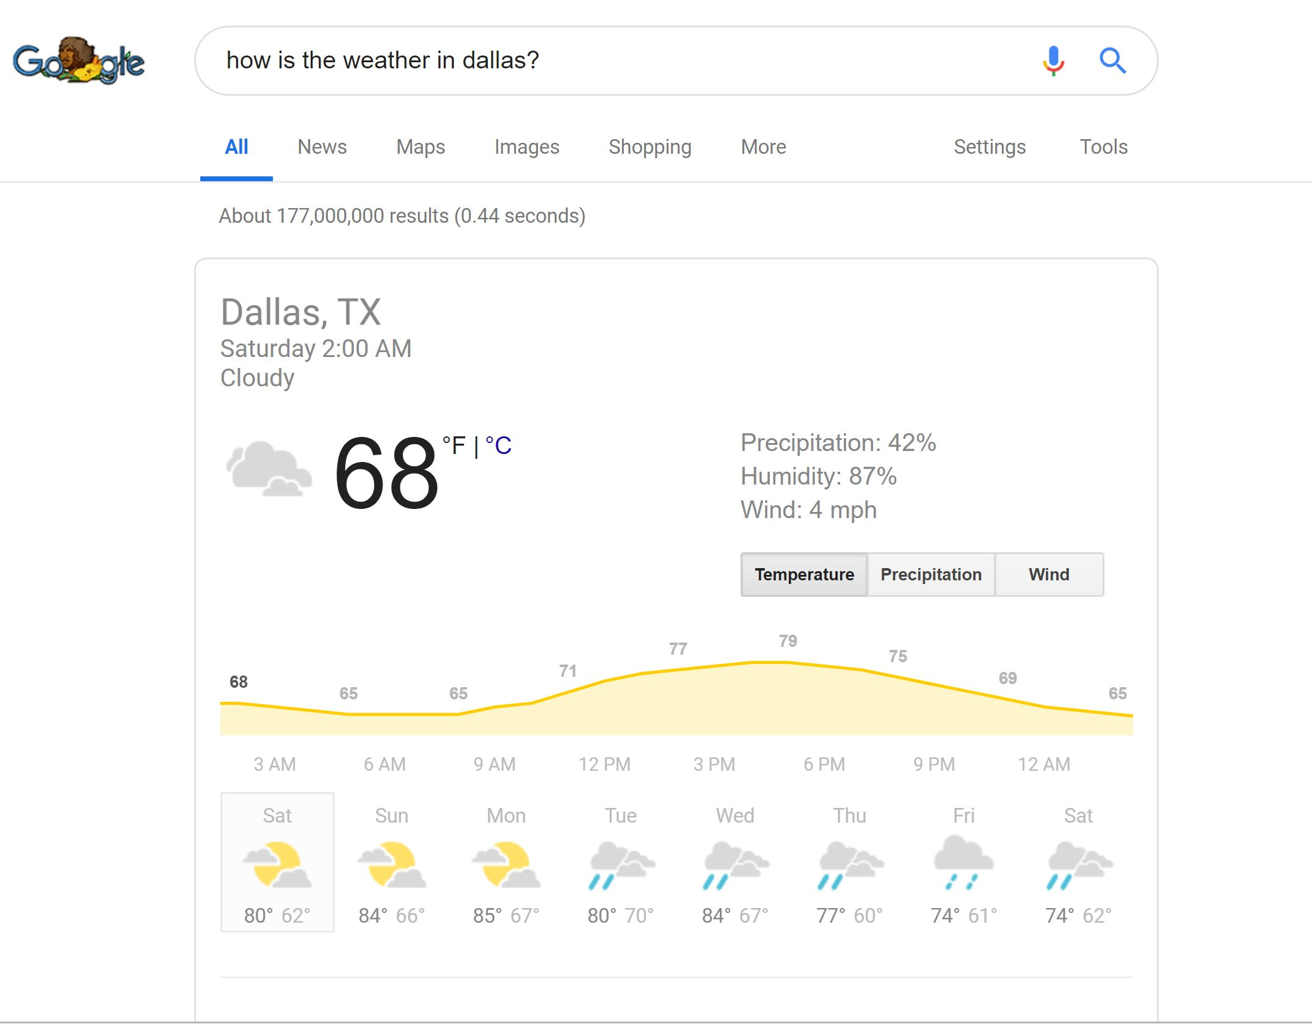
Speech Recognition
Speech Recognition
Speech Recognition
Google Simple Search
Show me photos from Tokyo.
How is the weather in Dallas?
What is a synonym for Brave?
Notes:
SpaCy: An industrial-strength python based NLP tool, mainy provide some useful functionalities, such as tokenizing, part-of-speech tagging, dependecy parsing, entity recognition, etc.
Textacy: Provide High-level APIs of Spacy, mainly for text normalization.
Scikit-learn: Python-based machine learning library. We used it for extracting latent semantic features and some of its simple models in blending.
Word2Vec, GloVe, FastText: Those are neural-based word embeddings, which represent a word as a real-valued dense vector. It captures nice syntatic and semantic properties in vector space. We used them for feature engineering and modeling.
Keras: High-level deep learning library, which made us easy to implement complex deep learning models.
XGBoost: An optimized distributed gradient boosting library. This offers another kind of non-deep-learning models for us to perform ensembling.

Slide 23
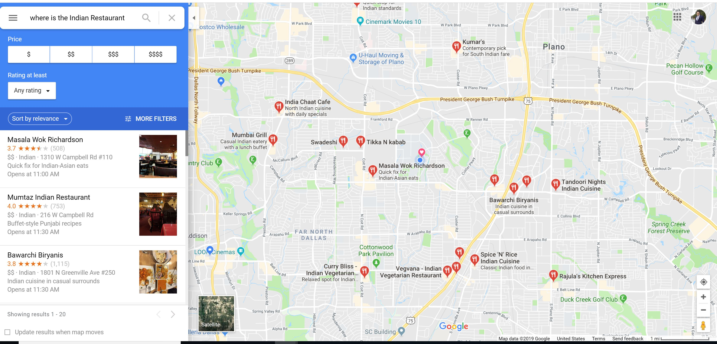
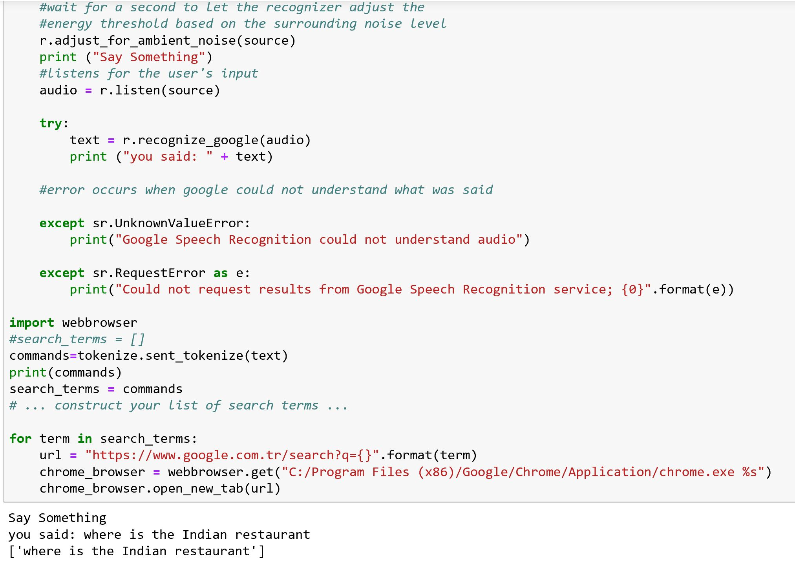
Speech Recognition
Speech Recognition
Speech Recognition
Google Map
Where is the Indian restaurant?
Give me the location of Walmart nearby
Notes:
SpaCy: An industrial-strength python based NLP tool, mainy provide some useful functionalities, such as tokenizing, part-of-speech tagging, dependecy parsing, entity recognition, etc.
Textacy: Provide High-level APIs of Spacy, mainly for text normalization.
Scikit-learn: Python-based machine learning library. We used it for extracting latent semantic features and some of its simple models in blending.
Word2Vec, GloVe, FastText: Those are neural-based word embeddings, which represent a word as a real-valued dense vector. It captures nice syntatic and semantic properties in vector space. We used them for feature engineering and modeling.
Keras: High-level deep learning library, which made us easy to implement complex deep learning models.
XGBoost: An optimized distributed gradient boosting library. This offers another kind of non-deep-learning models for us to perform ensembling.

Slide 24
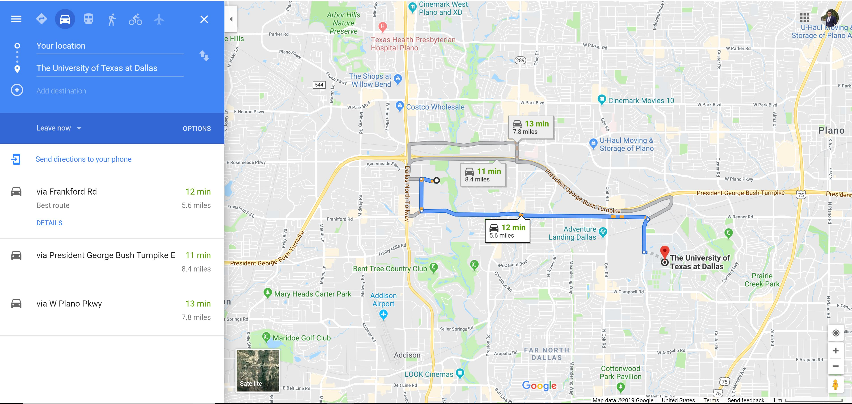
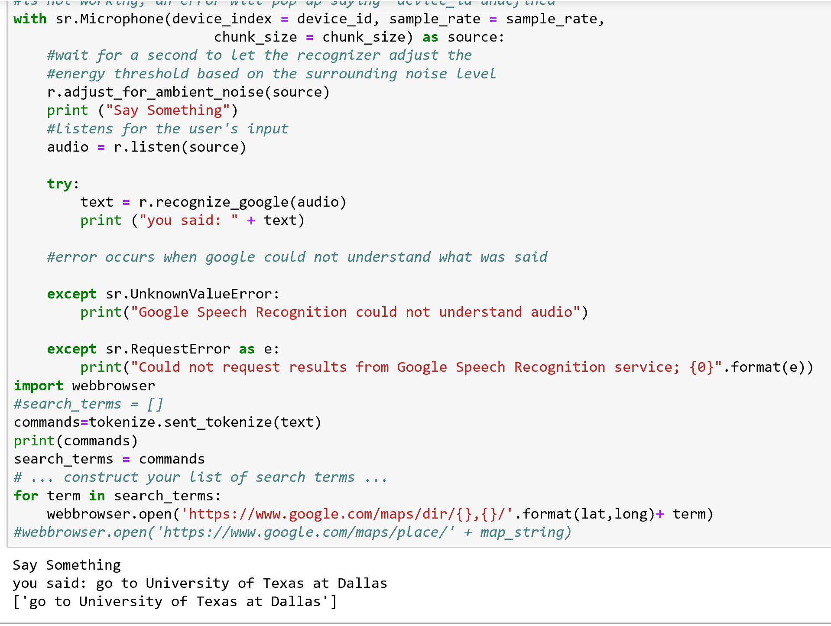
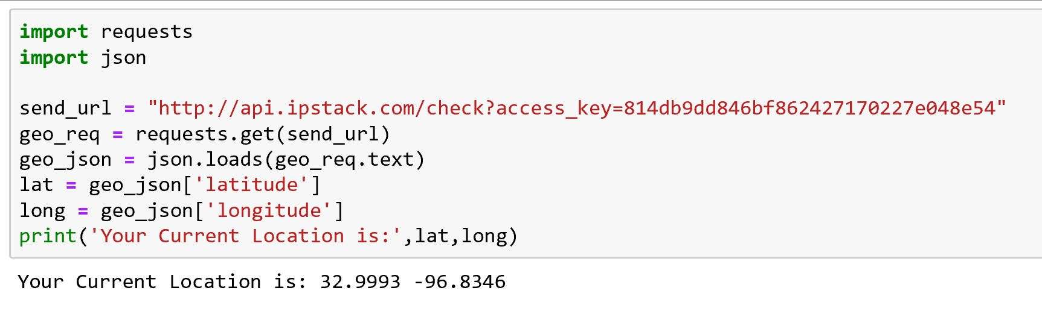
Speech Recognition
Speech Recognition
Google Direction
Go to University of Texas at Dallas.
What's traffic like on the way home?
How do I get to home by bus?
Notes:
SpaCy: An industrial-strength python based NLP tool, mainy provide some useful functionalities, such as tokenizing, part-of-speech tagging, dependecy parsing, entity recognition, etc.
Textacy: Provide High-level APIs of Spacy, mainly for text normalization.
Scikit-learn: Python-based machine learning library. We used it for extracting latent semantic features and some of its simple models in blending.
Word2Vec, GloVe, FastText: Those are neural-based word embeddings, which represent a word as a real-valued dense vector. It captures nice syntatic and semantic properties in vector space. We used them for feature engineering and modeling.
Keras: High-level deep learning library, which made us easy to implement complex deep learning models.
XGBoost: An optimized distributed gradient boosting library. This offers another kind of non-deep-learning models for us to perform ensembling.

Slide 25
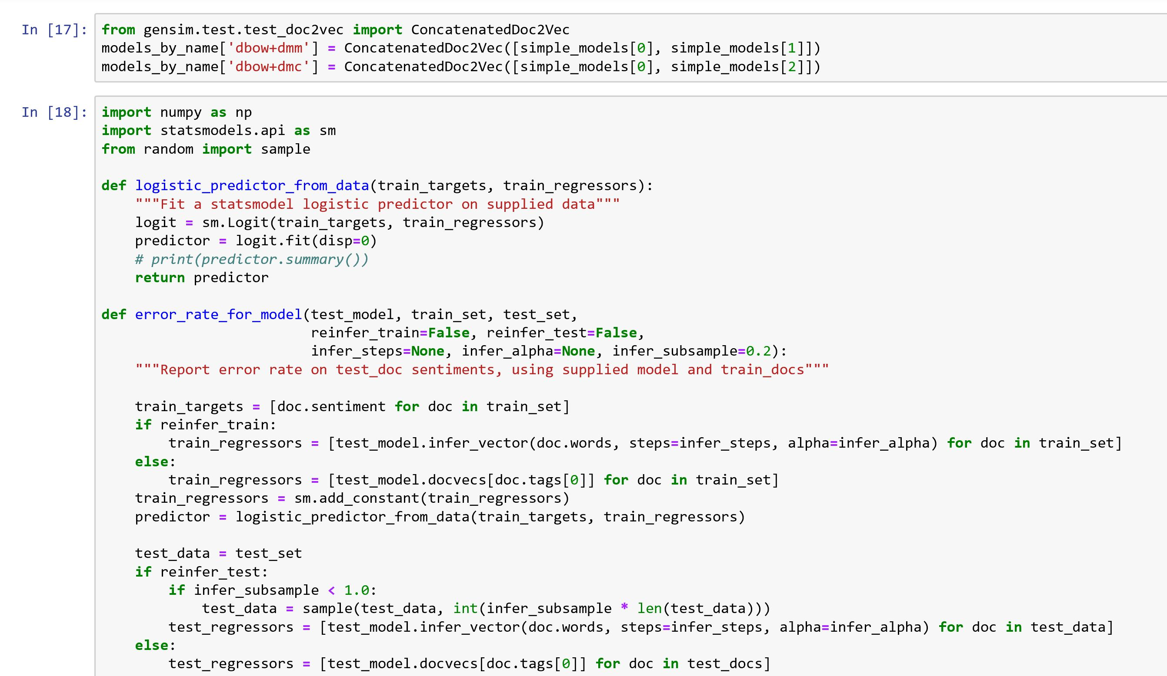
Speech Recognition
Speech Recognition
We will classify document sentiments using a logistic regression model based on our paragraph embeddings. We will compare the error rates based on word embeddings from our various Doc2vec models.
problem can be solved with Word2vec as well as Doc2vec. Doc2vec would give better results because it takes sentences into account while training the model.
Doc2vec solution
Combining a paragraph vector from Distributed Bag of Words (DBOW) and Distributed Memory (DM) improves performance.
Notes:
SpaCy: An industrial-strength python based NLP tool, mainy provide some useful functionalities, such as tokenizing, part-of-speech tagging, dependecy parsing, entity recognition, etc.
Textacy: Provide High-level APIs of Spacy, mainly for text normalization.
Scikit-learn: Python-based machine learning library. We used it for extracting latent semantic features and some of its simple models in blending.
Word2Vec, GloVe, FastText: Those are neural-based word embeddings, which represent a word as a real-valued dense vector. It captures nice syntatic and semantic properties in vector space. We used them for feature engineering and modeling.
Keras: High-level deep learning library, which made us easy to implement complex deep learning models.
XGBoost: An optimized distributed gradient boosting library. This offers another kind of non-deep-learning models for us to perform ensembling.

Slide 26
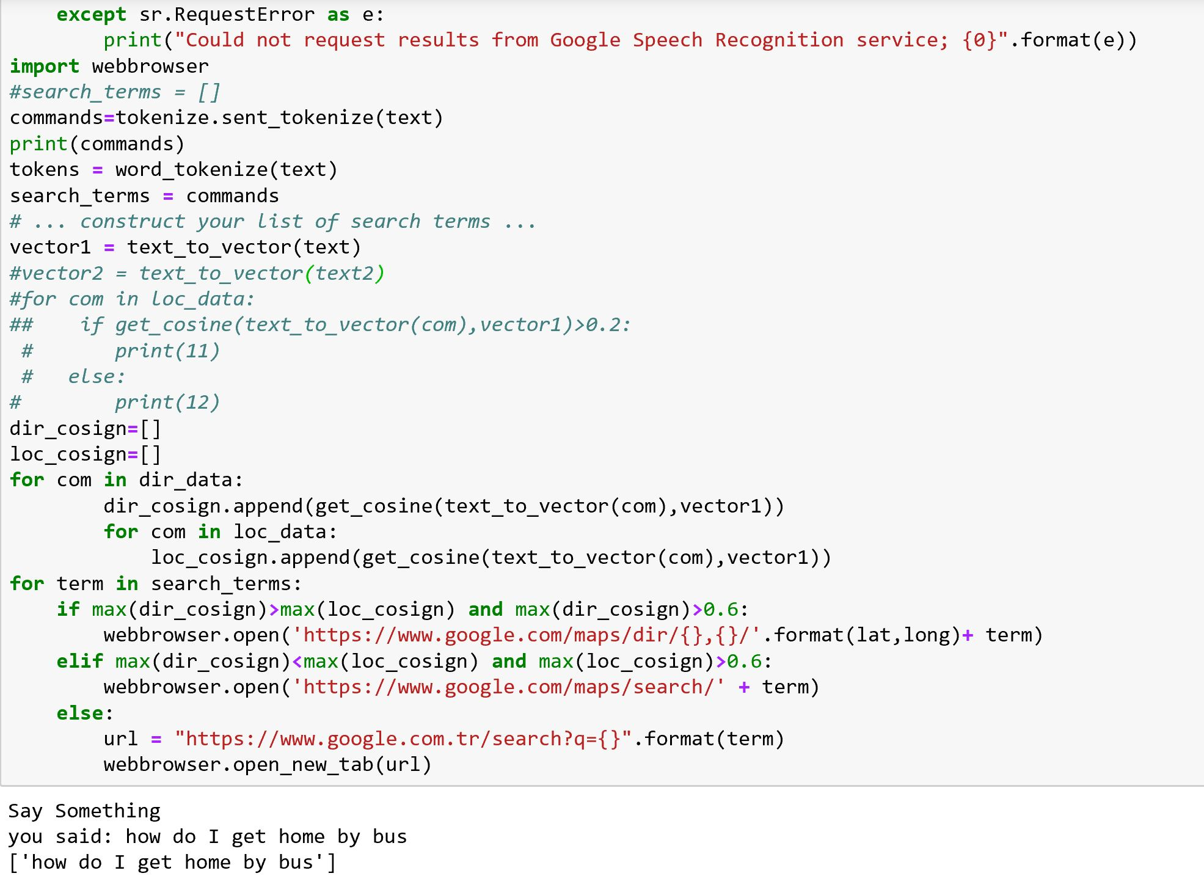
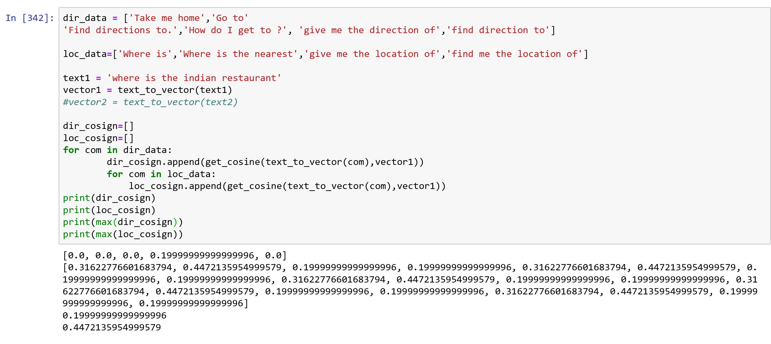
Speech Recognition
Categorized Search:
Google Search/Map/Direction
How is the weather in Dallas?
Go to University of Texas at Dallas.
Where is the Indian restaurant?
Notes:
SpaCy: An industrial-strength python based NLP tool, mainy provide some useful functionalities, such as tokenizing, part-of-speech tagging, dependecy parsing, entity recognition, etc.
Textacy: Provide High-level APIs of Spacy, mainly for text normalization.
Scikit-learn: Python-based machine learning library. We used it for extracting latent semantic features and some of its simple models in blending.
Word2Vec, GloVe, FastText: Those are neural-based word embeddings, which represent a word as a real-valued dense vector. It captures nice syntatic and semantic properties in vector space. We used them for feature engineering and modeling.
Keras: High-level deep learning library, which made us easy to implement complex deep learning models.
XGBoost: An optimized distributed gradient boosting library. This offers another kind of non-deep-learning models for us to perform ensembling.

Slide 27
REFERENCES
https://www.kaggle.com/c/quora-question-pairs/kernels
https://medium.com/mlreview/implementing-malstm-on-kaggles-quora-question-pairs-competition-8b31b0b16a07
https://github.com/eliorc/Medium/blob/master/MaLSTM.ipynb

Slide 28


